Slide 1
How to download a list of your bookings
Celcat Data Warehouse allows you to download a list of bookings from Celcat (.csv format). It is a useful way to double check your bookings.
Please note that Celcat Data Warehouse syncs every night at midnight, so any updates made today will not appear until tomorrow.

Slide 2
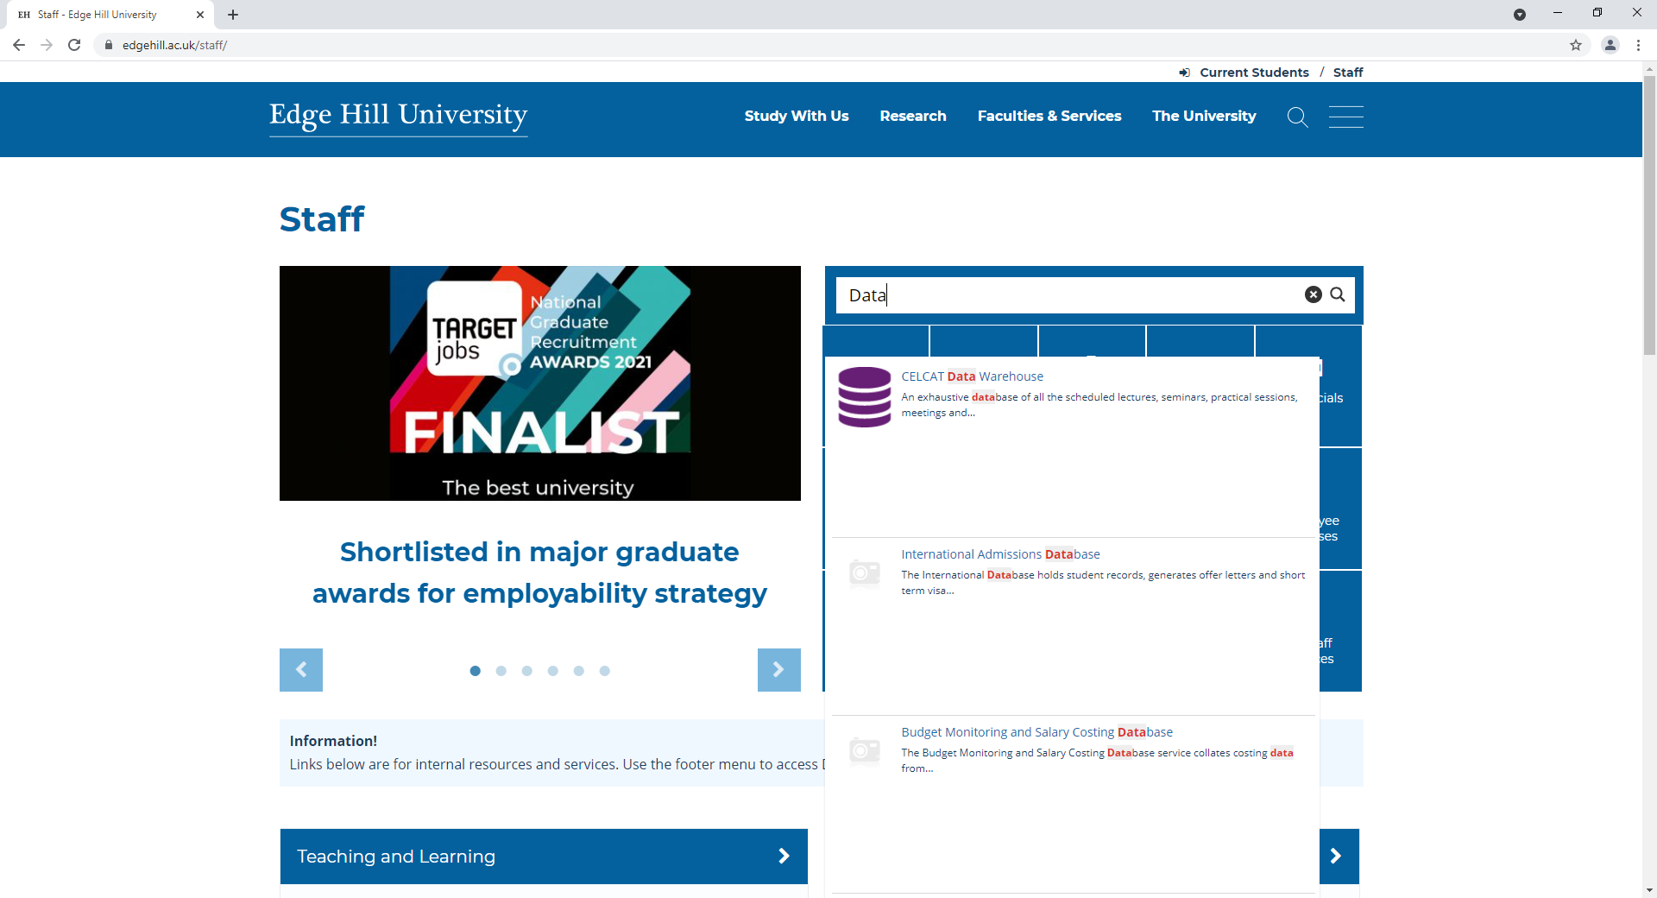
The Data Warehouse can be found by searching on the new Staff Homepage.

Slide 3
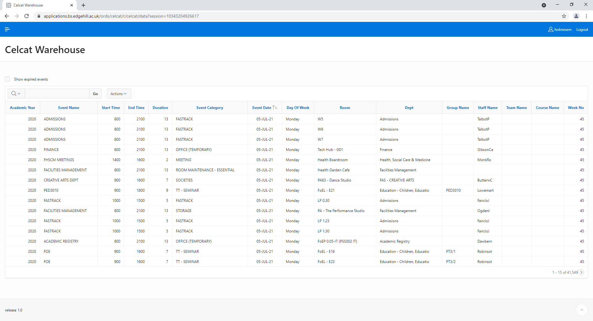
Single sign-on is enabled, so it should take you straight through to this page, but you might need to verify using MFA.
A list of all bookings in the whole of the Celcat timetable will appear.
There are a huge number of listings

Slide 4
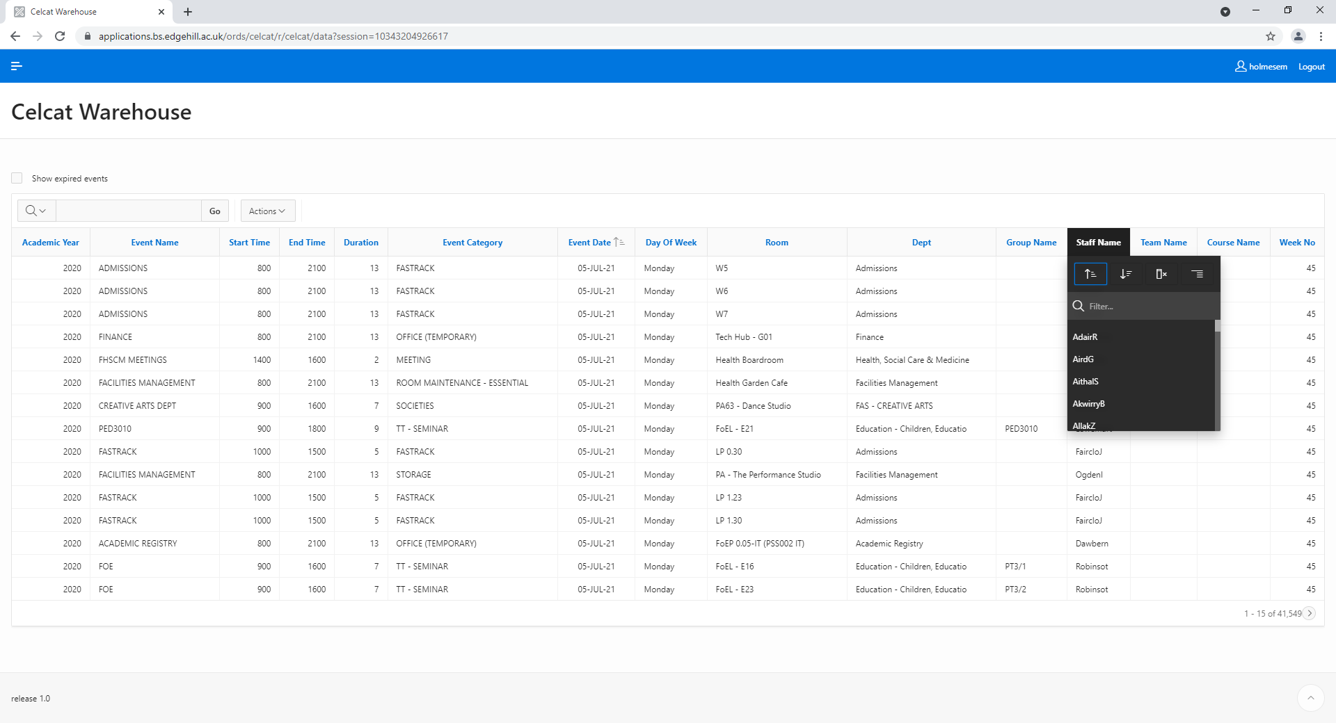
Click on the column titles to filter by the various fields.
Use the Event Name column to filter by module code.
If filtering by Staff Name, please use the username.

Slide 5
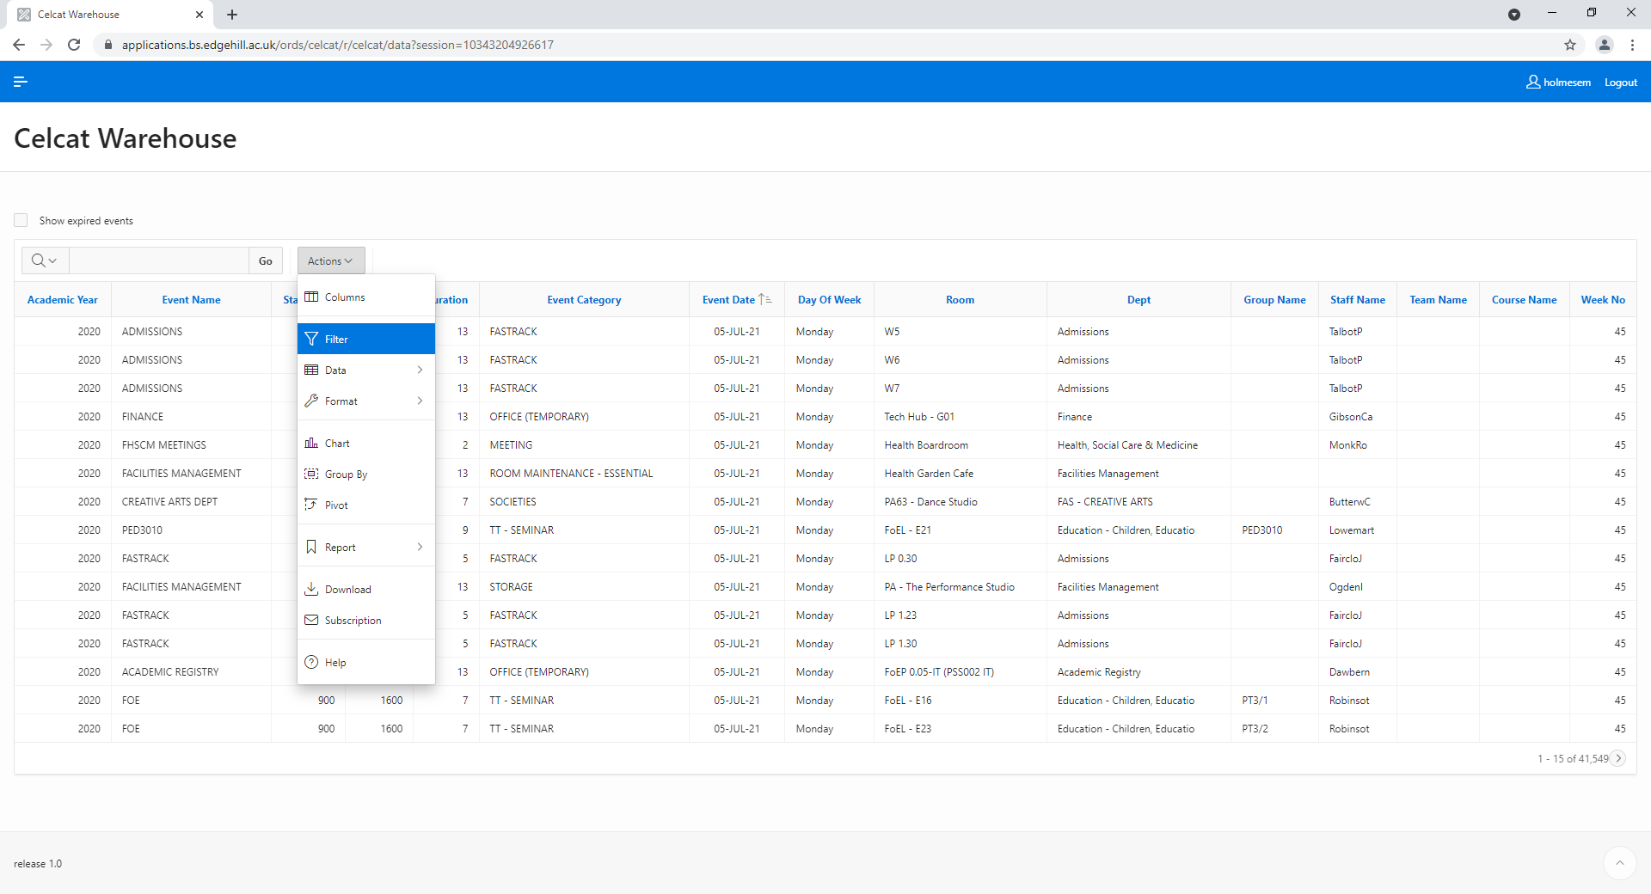
More advanced filters can be found by clicking on Actions and then Filter.

Slide 6
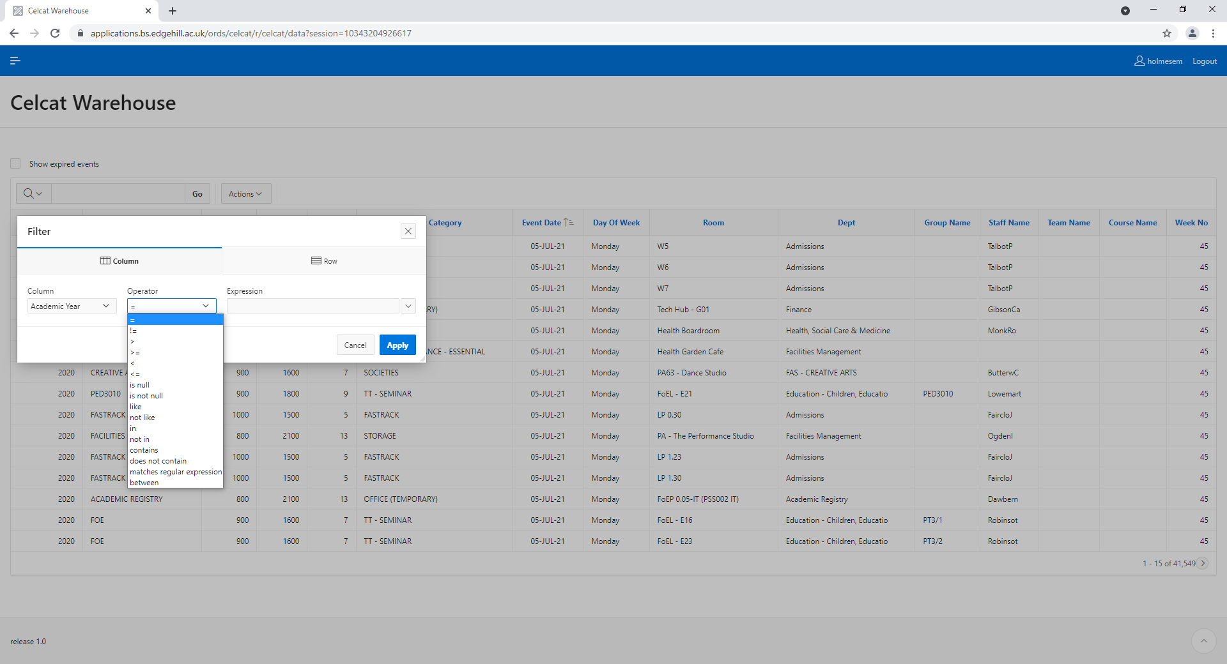
Use the drop-down Operator menu to choose different filter options.

Slide 7
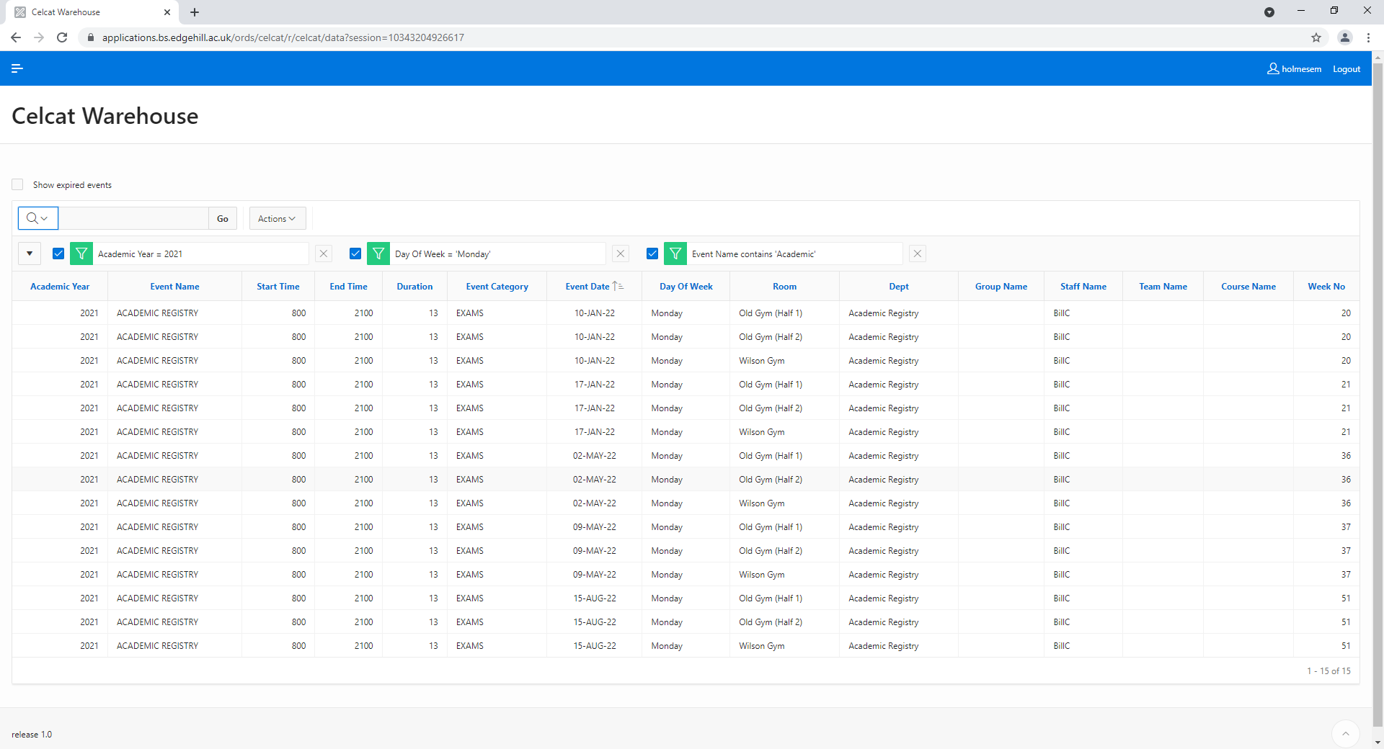
Multiple filters can be applied to narrow down the list further.

Slide 8
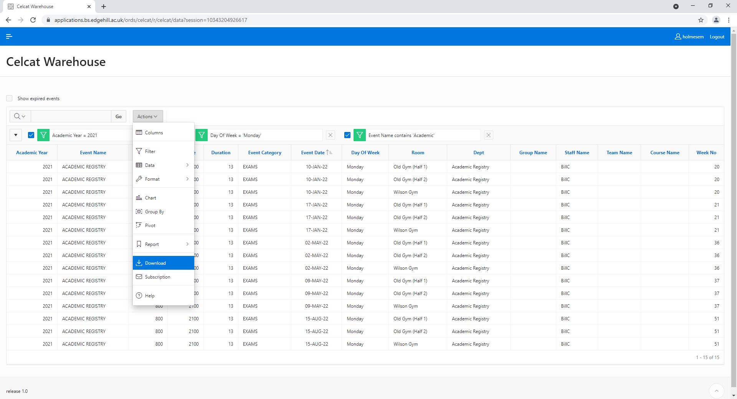
When you have filtered the list sufficiently, go to Actions and then Download.

Slide 9
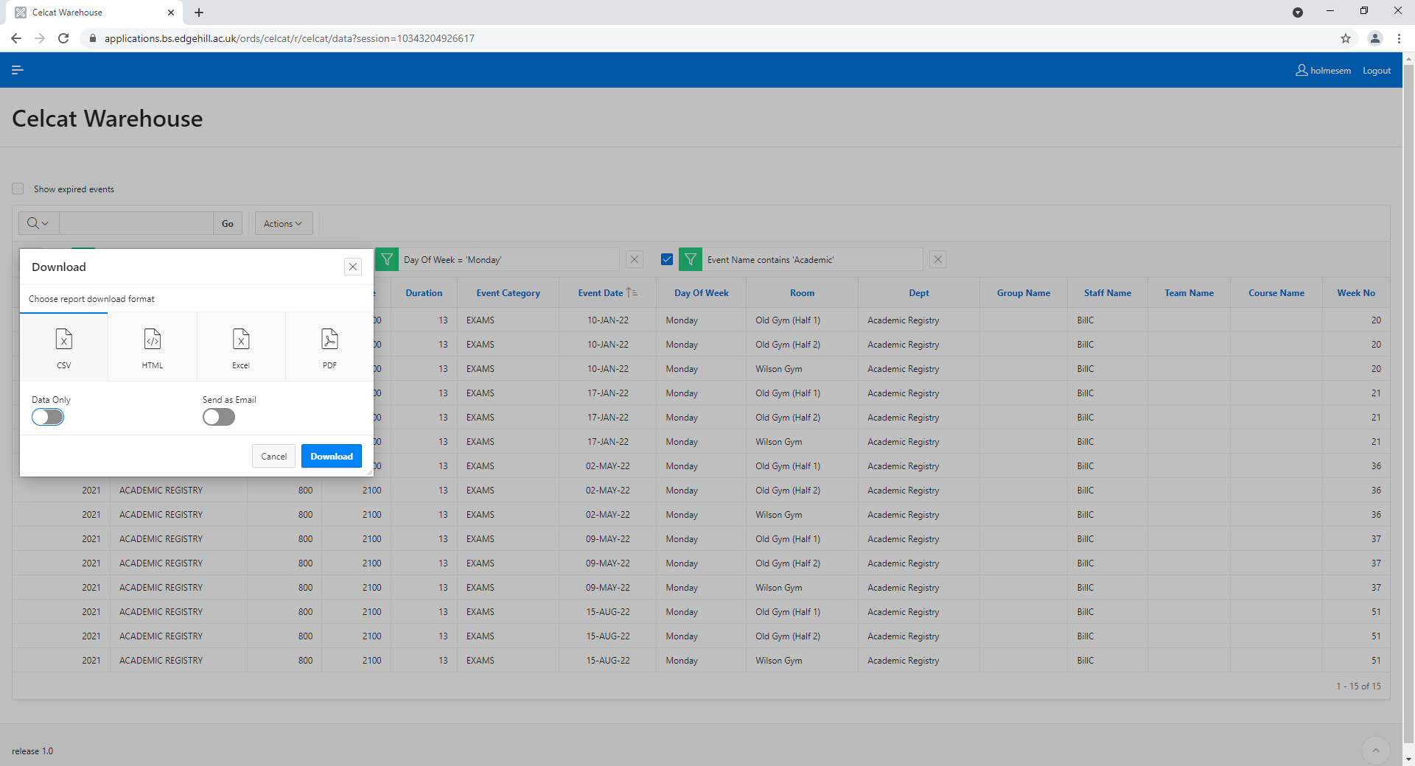
Choose the option for CSV and your download should start automatically.

Slide 10
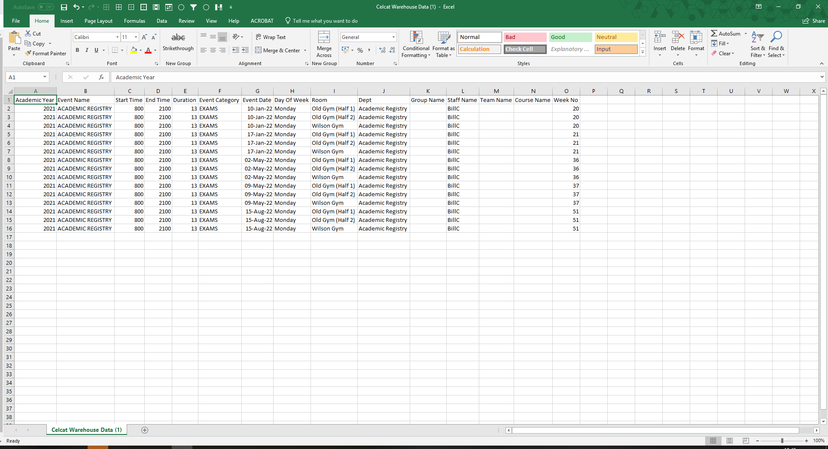
You can then manipulate the spreadsheet as required.

Slide 11
If you have any further questions, please email us (roombookings@edgehill.ac.uk)

