Slide 1




Applying to Study Medicine

Slide 2
Overview
Residential information
Entry requirements and information
Academic requirements
Contextual criteria
Preparing your application (admissions tests, academic attributes, non-academic attributes, work experience, personal statement, interviews)
Reasonable adjustments and fitness to practice
Q&A
UCAT information (2:30-3:00)

Slide 3
Residential – Tuesday 9th July – Friday 12th July
3 night/4 day residential based at Edge Hill University with visits to each partner medical school
  University of Manchester – Wednesday 10th July
  Lancaster University – Thursday 11th July
  University of Liverpool – Friday 12th July
Sessions at EHU and other institutions will be based around a case study to incorporate an understanding of CTBL, PBL, TBL
Sessions also include mock MMIs, UCAT workshops, clinical skills, team building activities, scavenger hunts and sports activities

Slide 4
Residential
Tuesday 9th July - arrival and registration from 10am until 11:30am
  Parents/guardians come along, there will be an optional welcome talk for parents at 11:30am
  Refreshments upon arrival
All food, accommodation and coach transport will be provided and free of charge
Financial support is available towards the cost of travel to the university – same process as with Campus Day

Slide 5
Residential Itinerary Overview
Day | Time | Activity
Tuesday 9th July | 10:00-11:30 | Arrival and Registration
 | 11:30-12:00 | Welcome Talk for students and parents
 | 12:00-14:00 | Move into Accommodation and lunch
 | 14:00-16:00 | CTBL Case Discussion and Team Activities
 | 16:00-18:30 | Group Activities – MMIs, UCAT
 | 18:30-22:00 | Tea and free time
 | 22:00-23:00 | Accommodation Curfew 10pm, Room curfew 11pm
Wednesday 10th July | 08:00-09:00 | Breakfast
 | 09:30-16:00 | Journey to UoM Medical School and Visit
 | 16:00-18:30 | Group Activities – MMIs, UCAT
 | 18:30-22:00 | Tea and free time
 | 22:00-23:00 | Accommodation Curfew 10pm, Room curfew 11pm
Thursday 11th July | 08:00-09:00 | Breakfast
 | 09:30-16:00 | Journey to LU Medical School and Visit
 | 16:00-18:00 | Clinical Skills
 | 18:00-22:00 | Tea, followed by a team building activity station night
 | 22:00-23:00 | Accommodation Curfew 10pm, Room curfew 11pm
Friday 12th July | 08:00-09:00 | Breakfast
 | 09:30-16:00 | Journey to UoL Medical School and Visit
 | 16:00-18:30 | Closing session then home time!

Slide 6
Residential – Important Info
Megan and Laura (Pathway Programme Admin at EHU) will be phoning all students next week to confirm your details
Please expect a phone call between 1pm-4pm on Monday 17th June -Thursday 20th June
The phone call will review your details, confirm your accommodation and dietary requirements, and is a chance for you to ask us any questions you may have!
It is essential that you answer this call, or phone us back between 9am and 5pm Monday-Friday

Slide 7
Studying Medicine
It's not like other degree courses
Longer (typically 5 or 6 years)
Professional training & clinical focus
Experiential learning (e.g., CBL, PBL, CTBL)
Established and new Medical Schools (cohort sizes)
GMC Outcomes for Graduates

Slide 8
Preparing your Medical Application:
What are Medical Schools looking for?
Motivated, Conscientious and Academically able
Insightful, Reflective, Values
Well-rounded, Resilient
Thoughtful, caring & compassionate

Slide 9
Preparing your Medical Application:
Academic entry requirements for standard entry
Standard A-level offer is AAA including:
2 sciences includingBiology/Human Biology or Chemistry (Manchester); Biology & Chemistry (EHU); any 2 of Biology, Chemistry & Psychology (Lancaster); Chemistry with either Biology, or Maths (UoL);
A third subject.
Adjustments for A*
GSCE:
At least 5 GCSEs at Grade B/6 or above (Biology, Chemistry (or double Science), English Language and Mathematics) (EHU)
8 subjects with points system. Must include combined Science (or Biology, Chemistry & Physics), Maths & English Language (Lancaster)
9 subjects. Must include English Language, Mathematics, Biology, Chemistry, & Physics (combined or triple Science) at minimum Grade B/6 (Liverpool)
At least 7 GCSEs at Grade A or A*(English Language, Mathematics, and at least 2 Science subjects are required at Grade 6/B) (Manchester)
Contextual data

Slide 10
Preparing your Medical Application:
Contextual routes into medicine
The British Medical Association supports efforts to attract medical students from a broader range of social backgrounds. For too long, various groups of individuals in society have been denied equality of opportunity in attending university or studying medicine.
There is a widely held belief, shared by the BMA, that doctors should be as representative as possible of the society they serve in order to provide the best possible care to the UK population.
British Medical Association (2009) Equality and diversity in UK medical schools, 8.

Slide 11
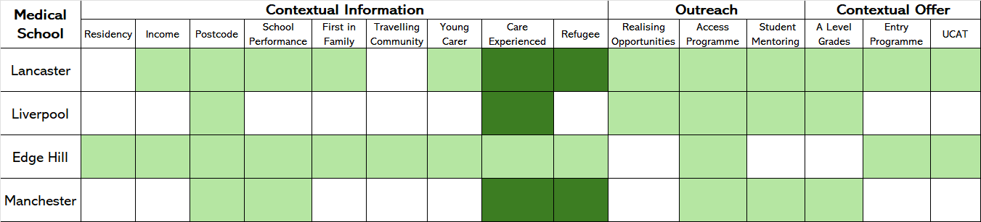
Preparing your Medical Application:
Contextual criteria

Slide 12
Preparing your Medical Application:
Gateway and foundation programmes
Edge Hill – A110 Medicine with a Foundation Year
  A Level: BBB or A*BC (inc./if Biology and Chemistry)
  GCSE: 5 inc. B/6 or above (Biology, Chemistry, English Language and Maths)
  MUST be resident local student from North West of England for at least 1 year
  Fulfil contextual conditions (inc. school performance)
Lancaster – A104 Medicine and Surgery with a Gateway Year
  A Level: ABB (inc./if Biology and Chemistry)
  GCSE: B/6 or above (Biology, Chemistry, English Language, Physics and Maths)
  Fulfil contextual conditions.

Slide 13
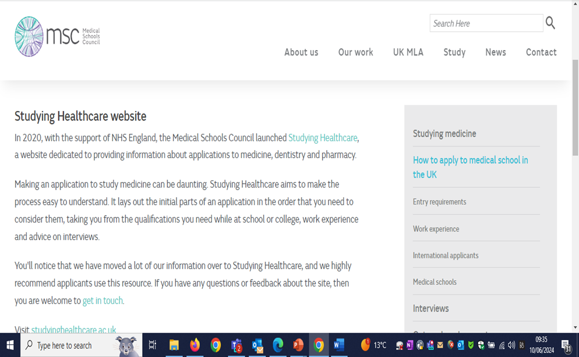
Preparing your Medical Application -F
Preparing your Medical Application
Preparing your Medical Application

Slide 14
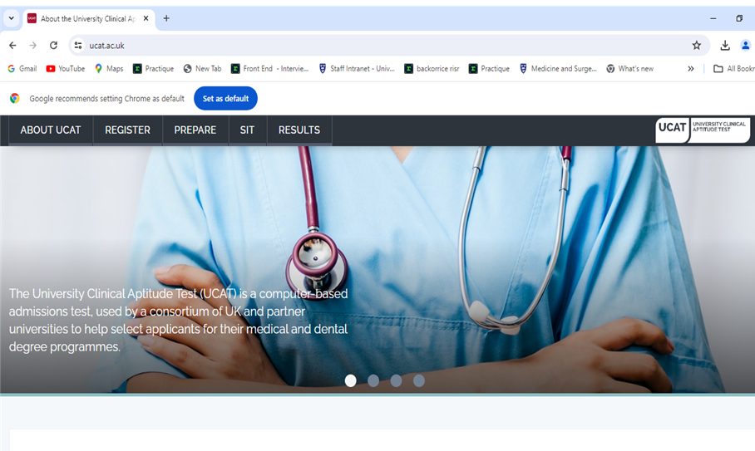
Preparing your Medical Application:
Admissions Tests
www.ucat.ac.uk
UCAT Essentials - What do I need to know?
Registration and Booking
UCAT Bursary Scheme
Preparation Advice and Resources
Test Day
Results
2024 Test Cycle Dates: 18th June Booking Opens
8th July Testing Starts
Medical Schools use these tests in different ways

Slide 15


Preparing your Medical Application: ​Non - Academic attributes
Consensus statement on the role of the doctor
MSC Statement on the core values and attributes needed to study medicine
Work experience guidelines for applicants to medicine (COVID-19)

Slide 16
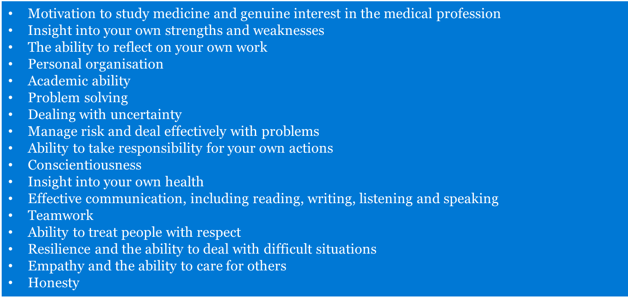
Preparing your Medical Application: ​
Non - Academic attributes

Slide 17
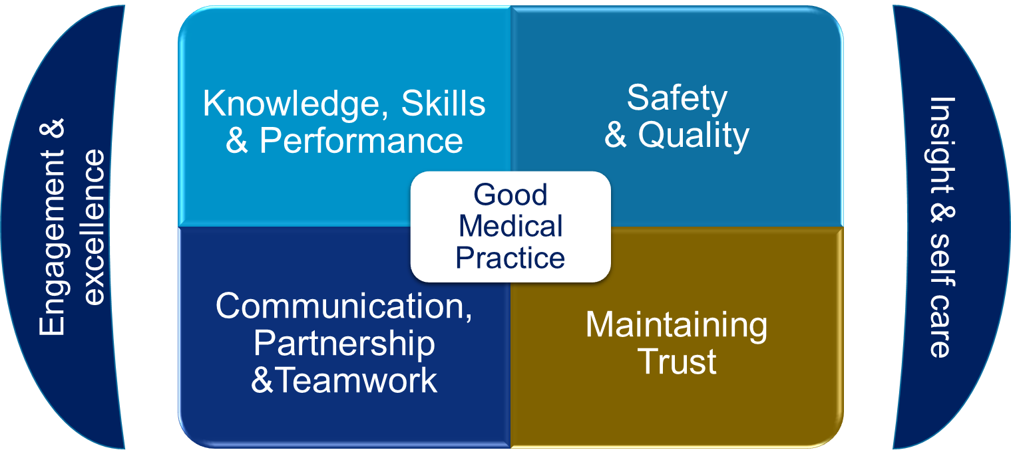
Preparing your Medical Application:
Non - Academic attributes

Slide 18

Preparing your Medical Application: Work Experience
Why is work experience needed?
Demonstrates steps taken to understand the role
Opportunity to observe a range of skills and interactions
Experience of different situations
Communication
Provides a platform for working with different people
What experience is appropriate?
Shadowing not required
Part time job
Volunteering
Online opportunities
Main point is to identify different skills that a doctor will require and how these have been developed

Slide 19
Preparing your Medical Application: Personal Statement
Reflect your experience, skills and attributes relevant to medicine.
Medical schools differ in their use of personal statements.
Important that:
it is written by you
it reflects you as a person
and is an honest reflection of your thoughts, skills and interests
Not a 'tick' list of opportunities
Addresses individual school issues where possible ( e.g. non-academic criteria)
Non-academic criteria at Liverpool
Health care awareness/insight
A caring contribution to the community
A critical, coherent and informative approach to verbal and written communication
The values that embody and underpin good healthcare practice
Evidence of the core values and skills required to be a medical student
Note: Individual medical schools may have specific requirements

Slide 20
Preparing your Medical Application: Interviews
Panel interviews (online or face-to-face)
Multiple mini-interviews
Personal skills, values and attitudes (ethical issues)
Communication skills (non-judgemental, problem solving)
Current health challenges
Understanding your career choice
Motivation
Reflecting on previous experience

Slide 21
Reasonable adjustments & Fitness to Practice
Probity
Health & medical conditions to be disclosed on your application to assess your ability to practice medicine, and if appropriate any reasonable adjustments
Occupational Health
Criminal Record: Disclosure and Barring Service (DBS)

Slide 22
Resources and support - PL
Medical Schools Council: https://www.medschools.ac.uk/
UCAS: www.ucas.ac.uk
UCAT: https://www.ucat.ac.uk/
Medical School webpages

Slide 23
Thank you
Any questions?

