Slide 1

What can we learn from elite athletes’ lived experiences about athlete sustainability?
Center for Child Protection and Safeguarding in Sport
Online Seminar Series 2023/24 hosted By Dr. M. Lang
26th of jUne 2024
ProF. Dr. Astrid Schubring

Slide 2
Outline
The field of research
The question
Theoretical starting points
The research study
Six learnings
Summary
Outlook
Tove Alexandersson, Orienteering
Schubring 26.06.2024

Slide 3
2. Previous Research on Athletic Careers
Today, research covers entire career pathway and within career transitions (e.g., John et al., 2021; Pummel et al., 2008).
Greater understanding of the embeddedness of athletic careers in individuals’ life course (e.g., Baur, 1989; Debois et al., 2012, 2015)
Establishment of career development models and research foci on ‘dual careers’ (Stambulova et al., 2019; Wyllemann & Lavallee, 2004).
Sociological research stresses the influence of social context (culture, sport organisations, policies, gender etc.) on athlete career development (Aarresola et al., 2021; Barker-Ruchti, 2019; Lang, 2020, Pedersen, 2001; Purdy et al., 2018; 2021; Schubring et al., 2023; Tekavc et al., 2020).
Schubring 26.06.2024

Slide 4
2. The question
What can we learn from athletes’ lived experiences about athlete sustainability?
Schubring 26.06.2024

Slide 5
3. Theoretical starting points
The lived experience
“A researcher or research subject’s human experiences, choices, and options and how those factors influence one’s perception of knowledge.” (Boylorn, 2008, p. 490).
“Centering lived experience provides a basis … to share expertise from different sources towards more effective and just outcomes.” (O’Leary & Tsui, 2022, p. 1076)
References: Mcintosh & Wright, 2019
Schubring 26.06.2024

Slide 6
3. Theoretical starting points
Sustainability science
Sustainability as a process and a goal, which can not be prescribed, but should be sought (Wals & Corcoran, 2010; Wals, 2011).
Sustainable development involves a collective effort of those effected by sustainability problems (Jickling & Wals, 2008; Barker et al., 2014).
=> To address sustainability issues in athletes and their careers, learning from athletes’ experiences is key.
Schubring 26.06.2024

Slide 7

4. The research study
  Project duration: 2021-2022
  Funding: Swedish Sports Confederation (RF)
  Swedish Ethical Review Authority approval
Qualitative case study (Yin, 2014)
Purposeful sampling of Swedish
top-athletes (n=18)
  medalled between 2015-2021 at WC,OG, PG
  world-class performance in leagues or professional settings
  individual and team (para)sports
  women and men
Schubring 26.06.2024

Slide 8
4. The research study
Data collection method
Online-survey on personal and career background
Biographical mapping interview (Schubring et al., 2019)
Data analysis method
Composition of individual portfolios for case-based analysis
Cross-case comparison and thematic analysis (Braun et al., 2016; Yin, 2014)
Descriptive statistics
Schubring 26.06.2024

Slide 9
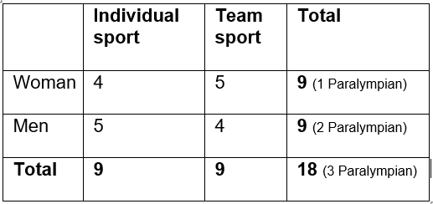
4. The research study
Jointly > 30 OG/PG medals, 70 WC medals, several Champions League and World Cup titles.
5 multiple Olympic/Paralympic medallists
Highest education: 3 upper secondary, 10 high school, 5 university
Performance investment: ø 14,75 years (min. 13 - max 17)
Schubring 26.06.2024

Slide 10
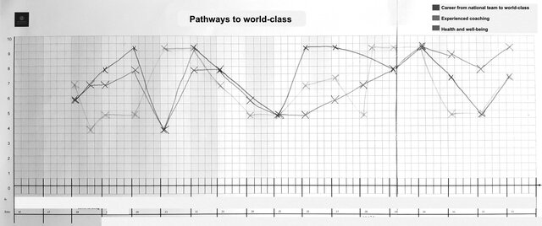
5. #1: Careers are not linear
Retrospective career timeline drawing created by an athlete in the Pathway to world-class study (Schubring et al., 2022).
Picture published in Schubring, 2024, p.133).
Schubring 26.06.2024

Slide 11
5. #2: There is not one way to world-class performance
__ Path to world-class
__ Path on world-class level
“Short pathway”, team sport athlete, summer
“Long pathway”, individual sport athlete, winter
Figures: based on Schubring et al., 2022, p. 28-29
Schubring 26.06.2024

Slide 12
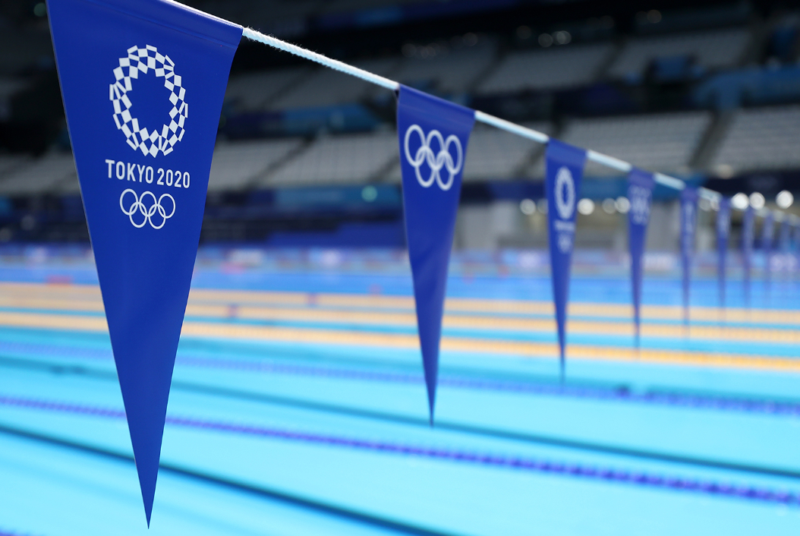
5. #3: The unpredictability of development
“The toughest thing has been 2020 with Covid. There haven’t been any
competitions, you didn’t get a penny in the company in general, so it was the toughest thing.” (Henric, multiple Paralympian)
Yannik – bankruptcy of club
“I think we've been very lucky actually. There’s been a lot of other people who’ve been much more impacted than we (in Sweden) have. Then the Olympics were pushed back a year and I think that was really just an advantage for me because then I got another year to train.” (Frank, Tokyo medal winner)
Schubring 26.06.2024

Slide 13
5. #4: Not all learning is good
"...two of the best years in your career and then you have to walk around and sort of stand in the shower and cry [...] he had so much power, that’s it, that’s the whole problem, that he had so much power over your everyday life, over your career, over your everything.” (Ida, teamsport)
Schubring 26.06.2024

Slide 14

5. #5: Context matters
“I've had an amazing career and a great time. I mean, I've made money. And you can also look back on that now and feel like this: "But wow. Imagine, I travelled all over the world, got to keep up with my hobby. Had my hobby as a job!" (Beata, individual athlete)
“They (family of the coach) were really nice…I got to rent a small apartment there (where they lived). I could work off the rent, so I painted a little bit... I had to work a little bit like that... I live in their garage now." (Tim, individual athlete)
Schubring 26.06.2024

Slide 15
5. #6: Athletes have agency
“Agency signals the capacity of individuals to perceive their situation, reason about it, consciously monitor their action, ..act independently, make choices” (Schwandt, 2015, p. 4)
'Can't I have [Coach B]?' Because I saw how good she was at talking about your whole life and didn't shy away if you said something difficult….So it was a pretty easy choice even though it was hard to disappoint [Coach A], but it was very important that I was able to switch to her.“
(Lara, individual sport)
Schubring 26.06.2024

Slide 16
6. Summary
Athletes’ lived experiences…
are a powerful, but partially neglected source of knowledge.
point to the complexity and unpredictability of career development.
raise new questions for research, sport governance and athlete development practices.
Schubring 26.06.2024

Slide 17
7. Conclusion
Sustainable career development requires…
accommodating for diversity and individuality of athletes’ pathways and life situations.
greater flexibility in athlete development system.
mechanisms to prevent and detect destructive learning and development.
support for athletes’ development of agency.
ways to diagnose positive and negative contextual influences.
Schubring 26.06.2024

Slide 18
Thank you for your attention! a.schubring@dshs-koeln.de https://www.dshs-koeln.de/visitenkarte/person/univ-prof-dr-astrid-schubring/ https://www.gu.se/om-universitetet/hitta-person/astridschubring
Schubring 26.06.2024

Slide 19
Selected Publications
Aarresola, O., Lämsä, J., & Schubring, A. (2021). "Chapter 16: Social perspectives on athlete pathways". In Research Handbook on Sports and Society. Cheltenham, UK: Edward Elgar Publishing. Retrieved Jun 5, 2024, from https://doi.org/10.4337/9781789903607.00025
Schubring, A., Halltén, M., Barker-Ruchti, N., & Post, A. (2023). Balancing risk-taking and self-care: The ecology of athlete health behaviour during the Olympic qualification phase. International Review for the Sociology of Sport, 58(8), 1326-1348. https://doi.org/10.1177/10126902231168098
Schubring, A., Grahn, K.. Rylander, P., Lundvall, S. & Bergström, E. (2023). Vägar till världstoppen: en studie av svenska toppidrottares karriärerfarenheter. Riksidrottsförbundet.
Schubring, A. (2024). Biographical Mapping Interviews. In Participatory Research in Sport and Physical Activity (p. 126-137). Routledge.
Schubring 26.06.2024

