Slide 1


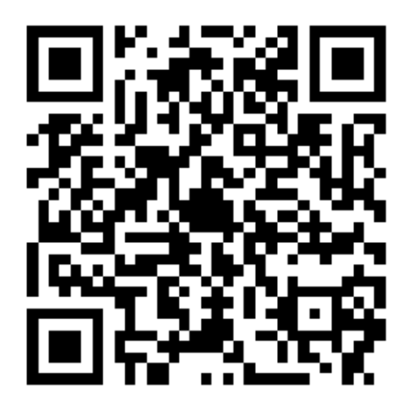

STUDENT LIFE
Welcome to...

Slide 2
The Student Life Team
Who are we?
  11 full-time staff members
  25 Campus Connectors
What do we encompass?
  Student Life Events
  Faith and Community
  International Student Support
  Induction and Welcome
  Scholarships and Student Opportunity Fund

Slide 3

What is Student Life?
We are here to…
Provide a warm welcome
Build connections and build your EHU community
Encourage you to get involved in ‘extra-curriculars’
Signpost you to opportunities and support (if you’d like it!)

Slide 4
Student Life & Thrive
Welcome Weekend Activities - Join our Campus Connectors at the Student Life Arch and find out about our evening activities
Student Life Fest – What to Expect - Your Student Life Officers will be hosting an online Q+A session before our Student Life Fest event
Student Life Fest Meet + Greet - We'll be meeting in the HUB before SLF so you can meet others to walk round the fest with and ask CCs any questions
Rollerdisco Meet + Greet - Get your skates at the ready with the CCs as we host a meet and greet for the Rollerdisco
Thrive x Get Connected - An exclusive collab with one of our Get Connected events, it's a great opportunity to meet other students
IKEA Trip Early Access – Want an excuse to grab a plate of Swedish meatballs? We'll be giving you early access to book onto our free trip to IKEA
Thrive x Saturday Social / Walk with Me - An exclusive collab with our weekend events including a meet and greet

Slide 5
Events
Student Life:
Student Life Arch
Get Connected
Commuter Breakfast
Therapy Dogs
Hub TV screen
Global Café
Welcome and Induction
Bespoke events
Residential Life:
Big Night In
Halls social
Saturday social
Walk with me
Learn2Cook
Halls Points
Trips

Slide 6
Student Life Portal
Events
  Regular Student Life events
  Campus Sport
  Arts Centre
  Inaugural Lectures
  Local events
Appointments:
  Coffee and a Catch Up
  Listening Ear
  International Student Support
Scholarships
Notes:
Filter by your interests, date, graduate attributes

Slide 7
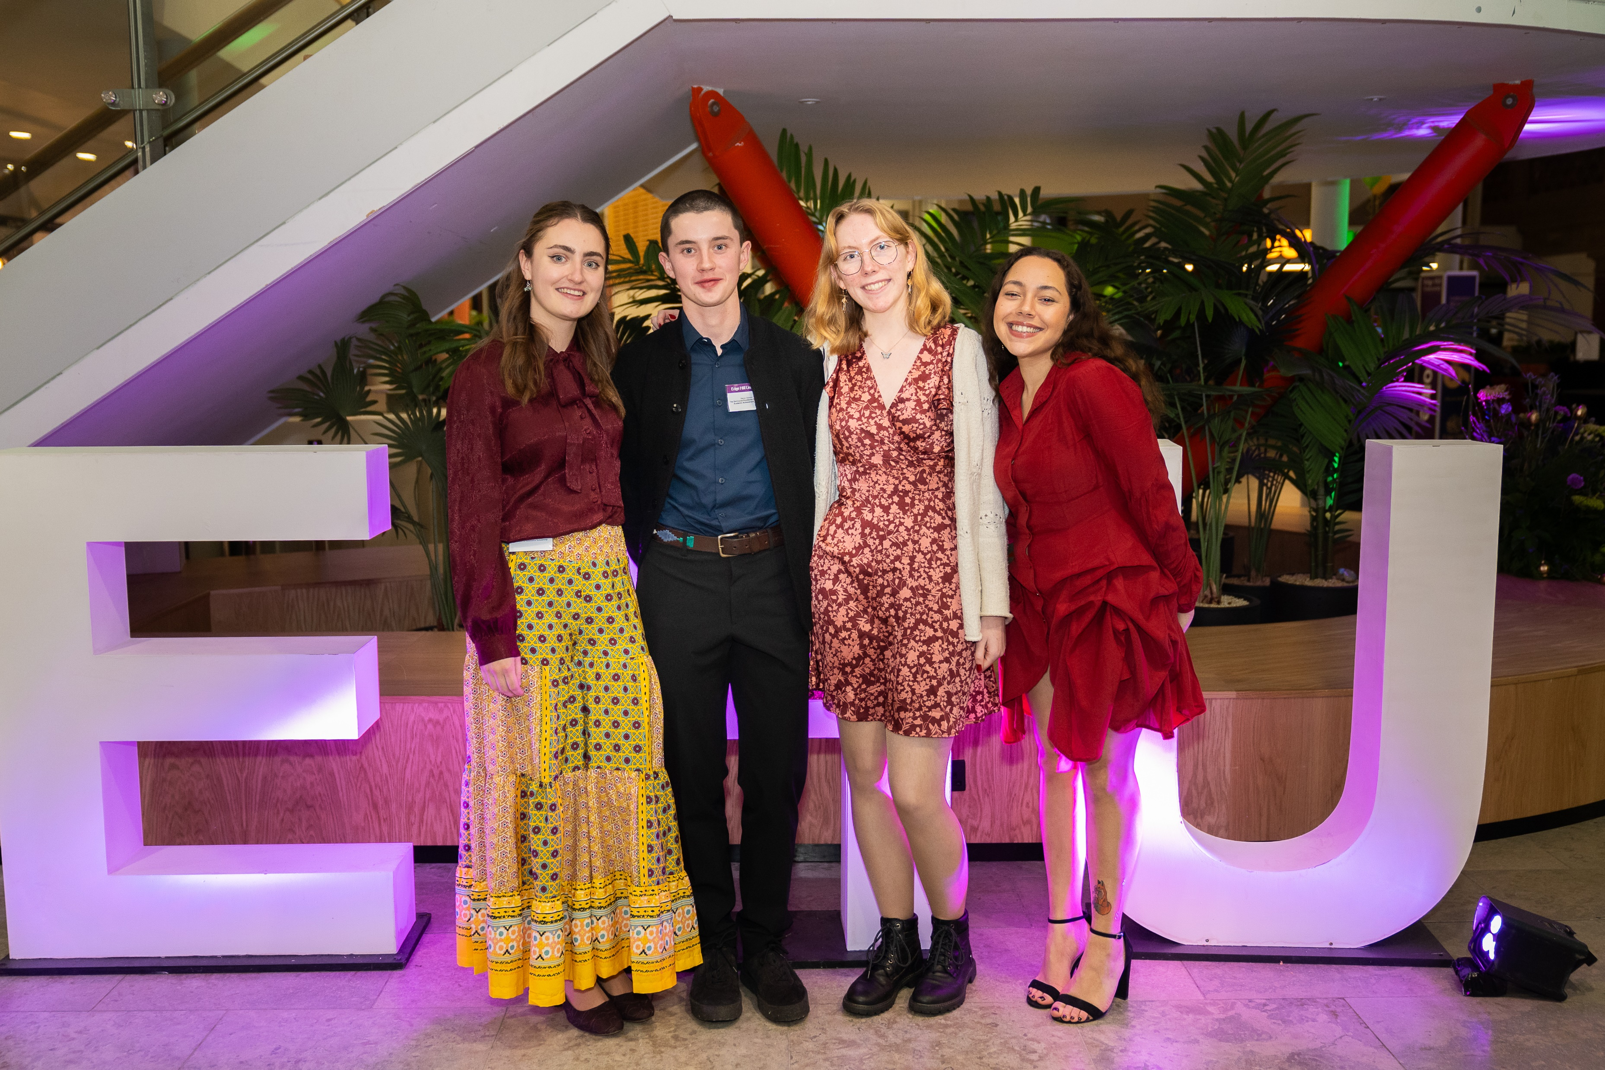
Opportunities
Student Opportunity Fund- Apply for up to £2000 per year of study!
Scholarships- Applications are scheduled to open February2024
Interview Clothing Collection- pop in for a browse at the Student Life Arch, or book a consultation by emailing scholarships@edgehill.ac.uk

Slide 8
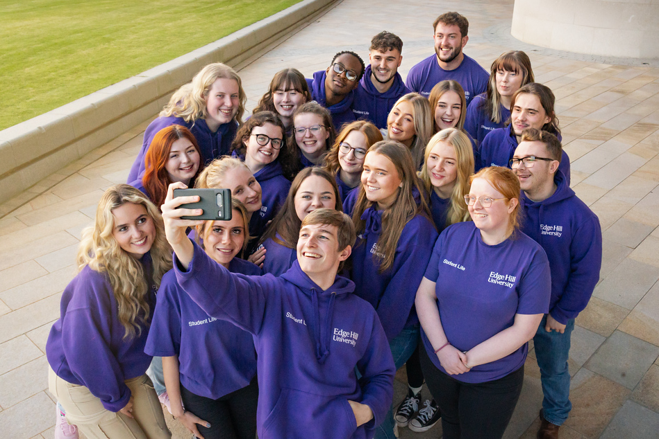
Thanks for listening!
Email: Studentlife@edgehill.ac.uk
Explore: Student Life Portal
Come and visit us:
Student Life Arch
Upstairs in the Hub
Events

