Slide 1
Thrive 1: Meet the Money Advice Team
Who we are
Where we are
How we work with students
What we do
Key Info and Tips to ensure you get off to the best possible start with your money
Notes:
Hello and welcome to Thrive programme’s Money Advice first session. Thanks for joining us today. This is one of a series of sessions put together by colleagues in Student Services, Learner Services and Careers for members of the Thrive programme, They’re all about giving you as much info as you need about the support services to help you through your studies,
(My name is Louise Jones and I’m a Student Support Office in the Money Advice Team.
There’s lots to get used to when you are starting University and money is one of those areas you need to be clued up on. You may be the first person in your family who’s starting university, you might not have had to manage money much before. You might be a mature student who is suddenly having to manage your finances on a different budget and over a term rather than a month. Whatever your circumstances or background, this session aims to introduce you to the Money Advice Team and the support we can offer.
So, in this presentation we are going to look at who the Money Advice Team are, where we are based, how we work with students, what we do and finally cover some tips to get you off to a good start with your money.

Slide 2
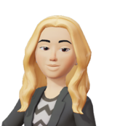
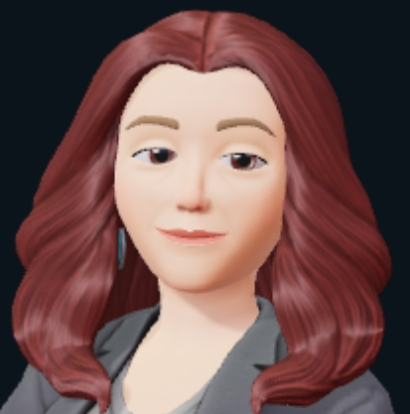
Meet the Money Advice Team
Lynds Shahida Paul Louise Laura Vic
Notes:
We like to call ourselves MAT for short. I asked the team to provide avatars of themselves for this presentation. We’re friendly, approachable, informative and non-judgemental. I can guarantee that we are real people and not AI!
Lynds is our Team manager and Money Adviser; Paul, Shahida and myself are also Money Advisers, Laura looks after our communications and systems and Vic is our Accounting expert who works in the background to ensure all our Financial support is processed and runs smoothly.
We have lots of experience between us and have backgrounds in Banking, Money Advice Service, Teaching, Student Support, Accounting and Finance. In addition to working at the University, some of us have worked in Colleges and Sixth Forms too with A level, Access and BTEC students both as teachers and advisers to those entering university. We are members of NASMA – the National Association of Student Money Advisors. In NASMA we work with other universities and colleges across England, Wales, Scotland and Northern Ireland to exchange ideas and work with other relevant organisations to promote the needs of students. NASMA also works with decision makers in government to influence student finance policy.

Slide 3
Where are we?
Based in Catalyst Building along with:
Student Services Teams (Wellbeing, Student Support Team, Student Experience Team, Inclusion
Careers
Learning Services – Library SpLD, Media and ICT support, Academic Skills and Blackboard Teams
Notes:
Where are we? We are based in the Catalyst Building where you will find the library. The Catalyst is really a central hub for Learning Services, Student Services and Careers Teams. We work closely with our colleagues in Wellbeing, Student Support Team, Student Experience Team and Inclusion in Student Services along with our colleagues in Learning Services and Careers. At our St James, Manchester Campus, support is available virtually and face to face appointments are available on request. Student Services will also be at Induction, Welcome Fairs and other events throughout the year.

Slide 4
How do we work with Students?
Talks and Presentations
Appointments
Email queries
Notes:
How do we work with students?
One of the ways we work with students is by providing talks and tailored sessions like today so you may also see us in your departments giving talks.
One of the main ways we work with students is to provide 30 min 1-1 appointments throughout the week. Appointments are available Monday to Friday between 10am and 6pm. You can self-serve by booking an appointment online by visiting the Money Advice webpage on the Edge Hill website. Appointments via telephone or through Teams can be selected but if you require a face-to-face appointment, please email moneyadvice@edgehill.ac.uk. If you select an appointment by Teams you just have to wait for the call on Teams, you don’t need a link.
At certain times, appointments can be fully booked, therefore if you find there are no available slots, please do check again the following day as new slots are released.
If you need a follow-up appointment, you can book in again.
We can also answer basic queries via email. However, for more complex enquiries we suggest to book an appointment with an adviser.

Slide 5
What we do….
Assess applications to the Student Support Fund
Signpost you for help with part-time job search
Support you to solve your money worries
Help you understand your Student Finance
Share tips on banking and budgeting
Provide advice on keeping your money safe
Help you to consider your finances after graduation
Notes:
So let’s have a closer look at what the Money Advice Team does.
Firstly, we help you to understand your Student Finance. We can do a financial health check for you if you are unsure if you are receiving the correct finance. We’ll look at how you can check some of this yourself a little later in the presentation. We can advise on what we think you might receive and how it’s paid. If you have a delay in receiving your Student Finance because of an issue with your application and have been unable to find out yourself what is wrong, we can ring our practitioner’s line with you during an appointment to try to get to the bottom of the issue.
2) Secondly, we can provide advice and give tips on banking and budgeting. We’ll have a look at banking a little closer later in the session and our second session in October will focus on budgeting and setting yourself a spending target.
3) As part of a wider look at your financial picture, it is likely that you may need to look for part-time work. 74% of students (nearly three quarters of UK students) work part-time whilst studying according to a Save The Student 2020 survey. We can signpost you to our colleagues in Careers in the part-time employment team for further help with this.
4) You may be worried about money; you may have personal debt or questions about benefits which some of our students can claim. We’re not benefit or debt advisors but we can give general advice and refer you on to specialist advice. It’s important to know that you can have a chat with us if you are having difficulties.
5) One of the main ways we can support students who may be struggling financially is through the Student Support Fund. From this pot of money we can support students with emergency support, if for example, they have a delay to funding. The main Student Support Fund provides non-repayable awards. If after doing a budget you feel that your basic expenses are more than your income and you may need support, you can apply to the Fund. If you are a student who is partly funded by the NHS Learner Support Fund such as Nursing, we advise you book in an appointment with the team before applying. Applications for most courses open 9th October 2023. but students on some courses can apply earlier and the application form is on our website. Applications take upto 4 weeks to assess.
6) We can also advise you on how to keep your money safe by avoiding scams for example. September/October can be a time when students particularly are targeted as they receive their first term's student finance. Student Finance England have recently issued a warning about 'smishing' by scammers pretending to be from Student Finance. Smishing is using text messages or Whats App to contact people to try to scam them out of money. Remember that Student Finance will not ask for personal details like bank details via Whats App or text. They also advise not clicking on links in a text message and messages that begin 'Dear Student.'
7) Finally, we can advise you on money matters after graduation when you are preparing for the world of work.
Help you understand your Student Finance
Point you in direction of part-time work
Share tips on banking and budgeting
Support you to solve your money worries
Assess applications to the Student Support Fund
Help you to think about life after graduation
Tree with icons for support

Slide 6
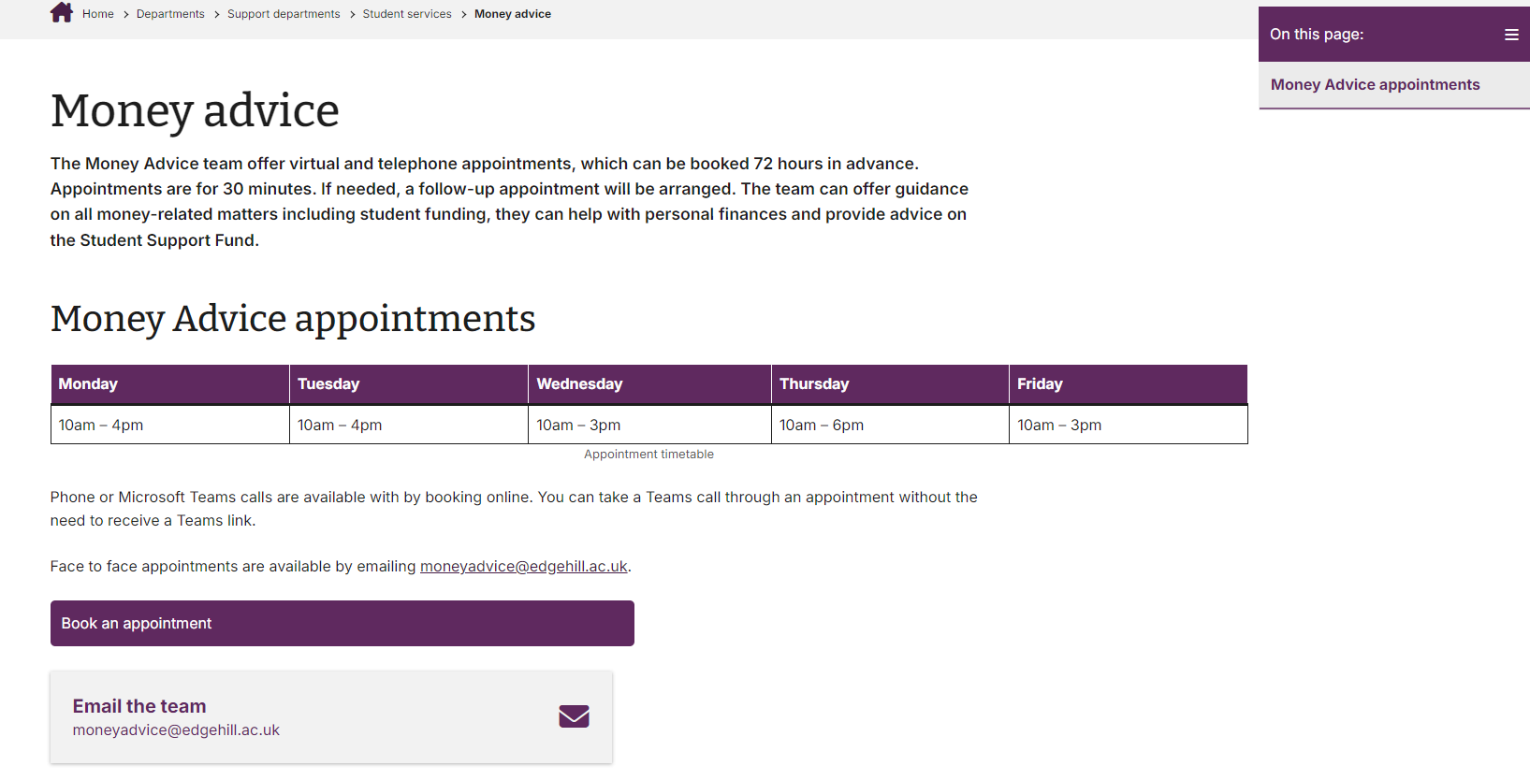
Money Advice Webpage
Money Advice Team
Notes:
There’s lots of information and advice on our website for all the areas we cover, such as Student Finance – the website is always worth checking first if you have a question before you make an appointment. You can often find the answer to the question there. It’s a really good resource to familiarise yourself with. All details of the website will be at the end of the presentation.

Slide 7
Key Info and tips
Check your Student Finance Award
Have you applied to Student Finance?
Have you received your Notification of Entitlement?
Apply for Student Finance up to 9 months after the start of your course each year
Student Finance assesses you
First instalment is released 3-5 working days after registration confirmed.
Once fully enrolled, Edge Hill confirms your registration to Student Finance
Notes:
So, we’re going to look now at some key things for getting off to a good start with your money, firstly checking your Student Finance Award.
So, let’s have a look at Student Finance, that could be Student Finance England, Student Finance Wales, SFNI etc. Who has applied to Student Finance? Hopefully by now you have You can apply after 9 months from the start of your course each year and remember that you apply yearly. You’ll be invited to apply late spring next year for your second-year funding.
Ok. so what are the steps? After Student Finance assesses you, and you are fully enrolled, Edge Hill confirms your registration to Student Finance and you are paid in 3-5 working days.! Ensure you have some money to cover you until your payment comes in – it won’t be on the first day!
When Student Finance assesses you, they will send you a breakdown of how much you should receive in loans and grants (if applicable). This is called a Notification of Entitlement. How many people here have received their NOE? Discuss poll.

Slide 8
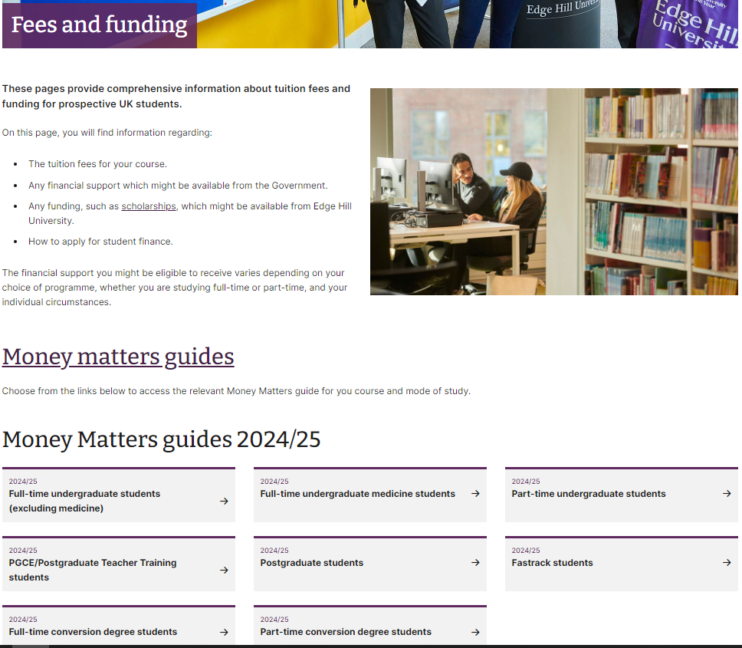
Fees and Funding Pages
Comprehensive Guides to Funding
Funding from Student Finance:
Maintenance Loan tables
Funding for Student Parents and those with Adult Dependents
Disabled Students’ Funding
Links to other UK Nations funding
Tuition Fee Funding
NHS Learning Support Fund for certain courses
Edge Hill Scholarships
Trusts and Charities
Notes:
We’re not going to look at checking all elements of finance that you may be eligible for in today’s session. We are going to focus on one element, Maintenance Loans and how you might check if your loan is right and what to do if it isn’t.
But our Fees and Funding page is a good starting point for checking all the funding available for …..

Slide 9
Maintenance Loans Student Finance England example 24/25 Starters on a 30-week course*
Where you are living | Minimum Maintenance Loan | Maximum Maintenance Loan (Household Income £25k or less)
Living with parents | £3,790 | £8,610
Not living with parents | £4,767 | £10,227
Loan tables
Notes:
So, how do you know whether you’ve received the correct amount of Maintenance funding?
What I’m going to focus on is Maintenance funding – the main part of the student funding that is meant for general living costs. In England these are maintenance loans and for those funded by Wales, Scotland and Northern Ireland this could be a mixture of loans and grants.
Let’s have a look at the minimum and maximum Maintenance Loan support that’s available for students starting in September 2023. We’ll use Student Finance England as an example. I’ve put some links in at the end of the presentation where you can find similar information for Wales, Scotland and Northern Ireland.
So, the amounts we can see here are for the year and then they are split into 3 instalments.
The minimum amount of loan is what everyone should receive, as long as you meet the eligibility criteria set by Student Finance. Depending on your household income you could receive amounts up to the maximum loans. Students with household income levels of £25k or less should get the maximum amount of loan. Students with household incomes more than £58,000 if living at home or £62,000 if living away from home can expect the minimum amounts.
You can see here that the amounts apply for standard 30-week courses Most courses are around thirty/thirty one weeks. Some courses, often with placements, such as Nursing can be a lot longer than this. Students who are on courses longer than 30 weeks can get what’s called a long courses loan, dependent on household income. This means that students on these longer courses may be entitled to higher maximum loans than seen here
You can see also that some students will receive a higher rate maintenance loan if they are entitled to certain benefits too. An example might be a lone parent who has a child under 20 in education.
We can see here that there is a difference between the loan available to students living at home with parents or those living away from home. This is because accommodation costs are one of the biggest costs whilst you’re at university, so Student Finance offers you a bigger loan. One of the things ew see with some students is that they have told student finance they are living at home when they later decide to move away – remember that you need to update SFE about your living circumstances so they can recalculate this for you – it can be done in the year.
The links I’ve put on the bottom of the page here will take you to the student finance calculator for England and the maintenance loan tables where you can check the amount of loan you think you might receive, based on household income from two tax years ago. The tables have examples of different household incomes the loan you should receive . If your household income drops by more than 15% this year and you’re receiving less than the maximum loan you can also ask Student Finance to assess you on this current year’s income too.
Remember if you’re recognised as a Care Leaver or Estranged form parents SF will not be looking at household income.

Slide 10
An example student Alex aged 18, a Psychology student, lives at home with her Mum and her younger brother who is at school. Alex’s Mum is single, she works and earns £12,000 per year and is also able to claim Universal Credit. She has been awarded a £3,790 loan for the year. Is she receiving the correct loan?
Notes:
So, let’s have a look at a quick example here. Alex, a Psychology Student, lives at home with her Mum and younger brother. Alex’s’s Mum is single. Her Mum works and earns £12,000 per year and is also able to claim Universal Credit. She has received a £3698 loan for the year. Is she receiving the loan she is entitled to?
Poll time again – what do you think?
No – she should have received a maintenance loan of around £8400. Alex’s Mum’s household income was under £25,000 and Student Finance don’t take into account her Universal Credit.
So why wasn’t she awarded the correct loan?
Two possible reasons. 1) Alex has not indicated on her application that she wanted to be means-assessed, ie for her Mum’s income to be considered. So, Student Finance have awarded her the minimum loan.
OR 2) Student Finance are still assessing her Mum’s household income evidence and have awarded her the minimum loan to make sure she has some money for the start of term. They may be waiting for evidence, but they give her the minimum to help her until that evidence is received. https://www.gov.uk/income-tax/taxfree-and-taxable-state-benefits

Slide 11
Are you like Alex?
Check you have selected to be ‘means-assessed’. If not, contact Student Finance for the relevant forms to complete
Check your online account and emails to see if Student Finance need anything and provide ASAP
Remember - many types of evidence can be scanned in and uploaded to your student account
Notes:
Can this be fixed? Yes! If Alex originally ticked that she didn’t want to be assessed on household income, she can change this by completing a form and then her Mum can provide her income details.
If Alex was expecting the full amount she needs to check her Student Finance online account to see what further evidence is needed. Lots of evidence can be scanned and uploaded to the account. Once any missing evidence is received, Student Finance will recalculate her payments and send a new notification. This will have new increased instalment amounts and should they should provide another payment before the end of the term to make up for any shortfall this term.

Slide 12
Ensure you get paid by your Funding body Other issues affecting receipt of Maintenance Loans and grants from Student Finance University has not been able to confirm your registration with Student Finance because: a) You have not completed your part/s of the enrolment process and /or b) You have not completed DBS/Medical/Health Checks/provided certificates if requested (only for specific courses) and/or c) Your application by Student Finance has not been assessed yet
Notes:
I do need to say before we continue that the vast majority of students will have no issues with receiving their finance on time, but we do see students in Money Advice who don’t receive any funding when expected. It’s because one or more of the reasons above

Slide 13
Delayed Funding?
Check emails re: enrolment stages
Check emails from Admissions re: outstanding evidence needed
Check your Student Finance account
Keep in touch with your Landlord/Mortgage provider about delays
Make an appointment with Money Advice if you think you may struggle financially – emergency support possible
Notes:
So, remember to check all emails regarding stages of enrolment, check any emails from Admissions about anything they need or actions you need to take and check on your Student Finance account for anything they may be waiting for. It may be that you are still being assessed. If you are experiencing delays in funding and you think you may struggle with money, please don’t hesitate to make an appointment with the team where we could look at some emergency support if needed to cover essentials.

Slide 14
Explore opening a student bank account
Main benefit – interest-free overdraft, subject to credit check
Don’t be swayed by the freebies!
If you decide to change your bank details, remember to inform relevant parties like Student Finance in plenty of time ahead of any change
More info on our MAT webpages
Notes:
What else might get you off to a good start? One of the perks of being a student is being able to open a student bank account. Many of you may opened an account already. The main advantage is the possibility of an interest –free overdraft, which can be helpful, It’s important to remember that it’s not your money and will have to be paid back but can be great as a tool to manage your money if used carefully when needed. Remember that you need to give some notice to Student Finance if you need to change your bank details. Most banks allows you to open student bank accounts up to 6 months after the start date of your course, so you could receive your first Student Finance instalment into your current bank account and then transfer it over.

Slide 15
Apply for Council Tax Exemption if needed
Step by step guide
Notes:
If are a single student living alone you would receive a 100% reduction.
If you’re living with one other adult who isn’t a student, you should receive a 25% discount
If you’re sharing a house or flat with other students, none of you will have to pay.

Slide 16
Explore Part-time jobs
Notes:
Part-time working is a good way to boost your income and gain some valuable transferable skills. As mentioned earlier, nearly 74% of students in a survey from 2020 took on part-time work. Remember that this about striking a balance between paid work and studies. As part of the Thrive programme you will be able to access some great opportunities and learn more about the support from the Careers team at Edge Hill.

Slide 17
Start a budget
Life skill
Challenging to budget over up to 15 weeks at a time
Support available
Notes:
You may be experienced at budgeting or completely new to budgeting. Whichever you are, students have an extra challenge as they get paid up to 15 weeks at a time whereas most people get paid monthly so it’s really important to budget as it’s more difficult to manage money over a longer period of time. We have a section dedicated to budgeting on our website with links to lots of budgeting apps and tools.
In our next session in October, we’ll look at setting up a student budget in more detail. Get a head start by taking some time to look at the resources on our Banking and Budgeting section of our website.

Slide 18
Wales/Northern Ireland/ Scotland links
Student Finance Wales
Student Finance Northern Ireland
Student Awards Agency Scotland
Notes:
So we’ve covered some key points to help you check your student funding and what to do if it’s incorrect or you need more help. We’ve also covered some other things to look at as you start your course.
As promised - these are the links to other Nations Funding – I know the session is being recorded today so you should have access to those links if needed.
.

Slide 19
Contact details
Money Advice Team
Notes:
These are the details of our webpages and email address,. Email in or book an appointment if you need any help or advice that can’t be found on the website, including if you have delays to your finance and need some short-term support.

Slide 20
Thanks for listening…and Questions!
Notes:
Thank you for listening
Please feel free to post of ask questions…..

