Slide 1
Student Support Team

Slide 2
Meet the Team!

Slide 3
Who are we?
The Student Support Team are on hand to support you. We are based in the Catalyst building and offer a mixture of virtual an in person appointments
At Edge Hill we’ll be here to support you from the very start of your studies or apprenticeship program.
We are here to discuss your options and offer help and guidance to support you.
We are on hand to help you if you are struggling or thinking of leaving the University.​

Slide 4
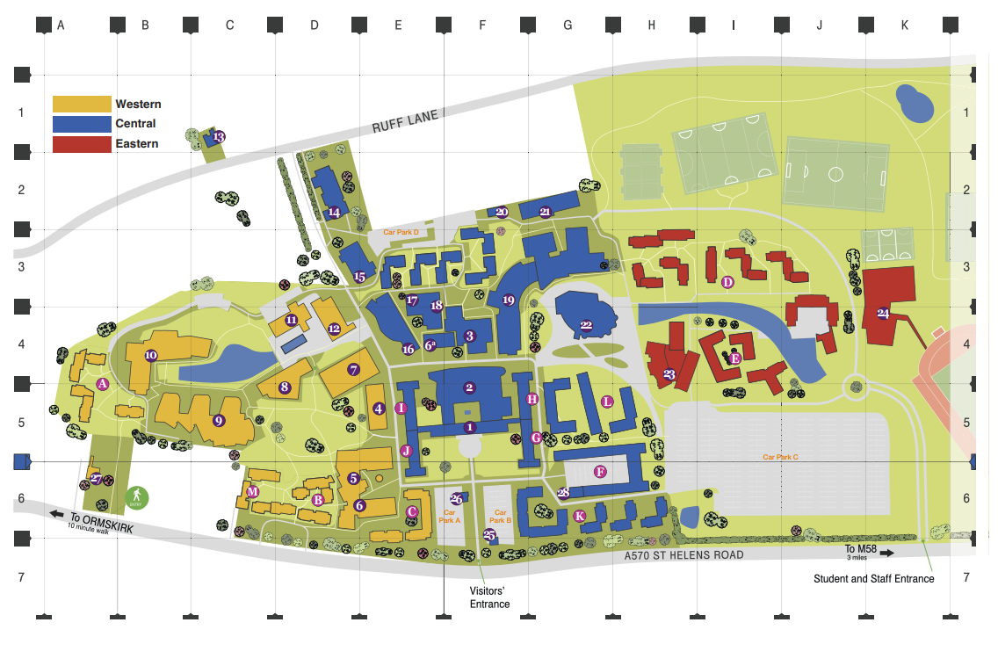

Slide 5
How can we help?
Feeling overwhelmed
Settling in
Not sure where to go for support
Longer term support
Work/ life balance
Help with options
Thinking of leaving University

Slide 6
Feeling overwhelmed?
Key stress points of the Academic Year
Starting Uni
Transition to Uni
Lots going on

Slide 7
Unsure of available support?
Student Services
Learning Services
Your Department
Careers
Facilities Management
External Services

Slide 8
Thinking of leaving?
Not enjoying your course
Change in career pathways
Unsure on options available
Worried about assessments
Don't think it is the right time

Slide 9
What happens in an appointment with us?
We…
Talk to you about everything you have going on
Look at what support is available
Talk through your options
Discuss next steps and actions
Support you to access and manage any support needed
Offer Follow up appointment and ongoing support if needed

Slide 10
Dedicated Support
The Student Support Team are also the designated support team for the following student groups
Care experienced and Estranged students
Young Adult Carers
Transgender Students
Pregnant Students
We offer bespoke 1-1 support for each student group and we are on hand for support for the duration of your studies at Edge Hill.

Slide 11
Care Experienced and Estranged Student Support
Your Support Package:
• 365 days in university halls of residence for the duration of studies
• Priority access to the Student Support Fund
• Pastoral support throughout your time here from the Student Support Team
• A dedicated contact in the Careers department to support employability
• £1000 a year care leaver bursary, for up to three years* (subject to eligibility)

Slide 12
As part of the Thrive programme we will:
Offer bespoke one-to-one support
Reach out to you at different points in the year to check in
Be on hand if you need us!

Slide 13
How else can you access us?
We will reach out to you at different times of the year to see if you would like to chat.
You may be referred by your tutor, Thrive coach or another service such as Wellbeing or Money Advice
Email us directly: StudentSupportTeam@edgehill.ac.uk
Book an appointment

Slide 14
Any questions?
StudentSupportTeam@edgehill.ac.uk

