Slide 1
THRIVE 2024/25
Jo McKenna – Student Success Officer

Slide 2


Slide 3

What is THRIVE? (1)
THRIVE is an on-course support programme for first year, undergraduate students who self-identify as having one or more Widening Participation characteristics.

Slide 4
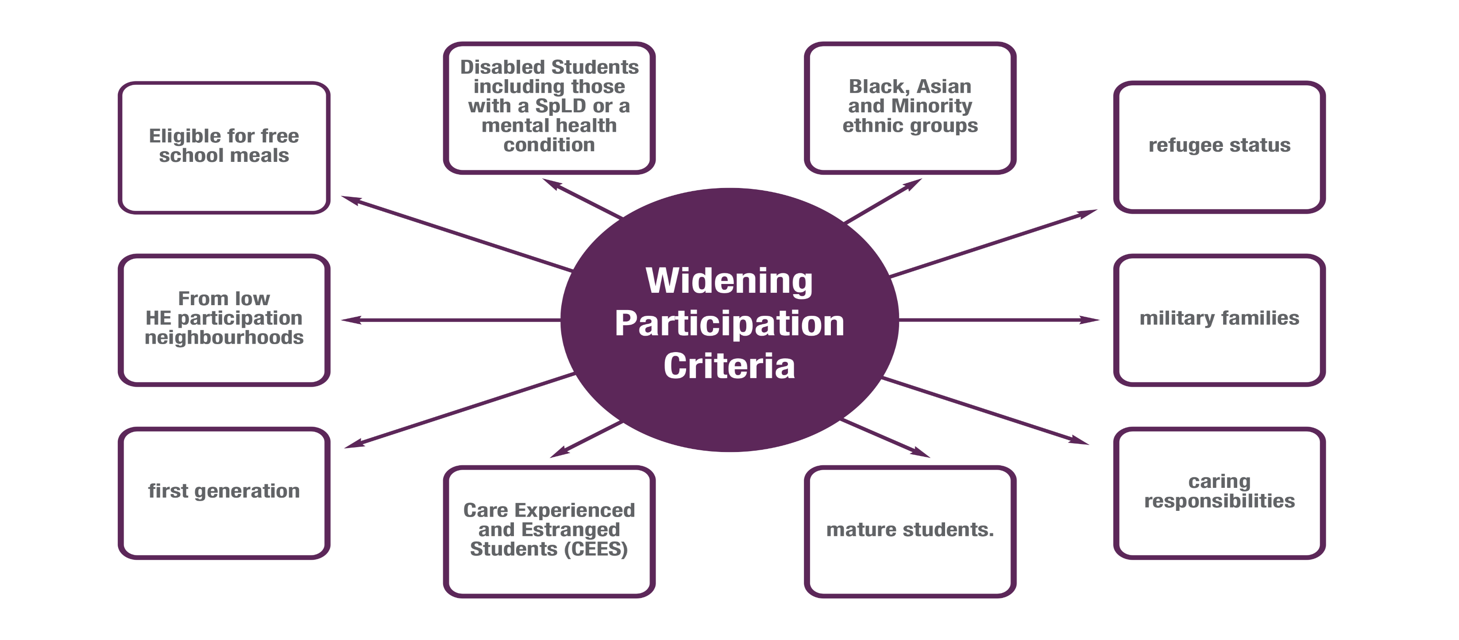

Slide 5

Designed by students, for students…
Coproduced with existing, and past students (Student Advisory Panels)
Joining our Student Advisory Panels is another great opportunity on offer for you here at Edge Hill
Paid opportunity to share your lived experience to make real life changes for the better at Edge Hill
Recruitment will take place over October and November (more information to follow)

Slide 6
Why THRIVE?
To help me over come my worries / fears of University
Smooth transition into university life
Help and support with finances
To boost my confidence
To get the best experience at university
To gain support and skills
To build positive relationships with others
To get the most out of university / to feel at home in university
To meet similar people

Slide 7
Why THRIVE?
We really want to support you to maximise your university experience!
Over 70% of EHU students come from underrepresented backgrounds, you are not the minority!
Sector wide disparities in Access (enter university), Success (on course) and Progression (graduate level employment or further study) which we are dedicated to reducing!

Slide 8
Please watch the following short video from the Office for Students (the regulator of English Universities) for more information;
https://www.youtube.com/watch?v=03U6ZLojiFk

Slide 9
What is included on THRIVE?
THRIVE is made up of a variety of exciting activities and opportunities. You can opt into the opportunities and activities that are in line with your interests and are at times that work for you.
4 Key components;
Pre-Arrival
On Course
Optional 1:1 coaching conversations with a member of Edge Hill staff
Student Opportunity funded trips and experiences

Slide 10
Virtual Pre-Entry Intro Sessions
Session | Booking / Session link | Date and time
THRIVE Programme Launch | Join the meeting now 11am Join the meeting now 1pm | Monday 19th August 2024 11am or 1pm
SPLD, Inclusion and Wellbeing Information Session | Join the meeting now | Thursday 22nd August 2024 - 10-11am
Student Life and Student Support Team Information Session | Join the meeting now | Tuesday 27th August 2024 - 1-2pm
Careers and Money Advice Team Information Session | Join the meeting now | Thursday 29th August2024 - 12-1pm
Students Union Information Session | Join the meeting now | Tuesday 2nd September 2024 1-2pm
Uniskills and Personal Tutor Information Session | Join the meeting now | Thursday 5th September 2024 - 12-1pm
You have received a link to the Pre-Entry Session webpage in the “Welcome to THRIVE” email sent on 17th August 2024. We will also pop it in the chat box today.
Sessions are an opportunity to meet the teams and get an overview into what they do and how they can help support you!
Please complete the attendance form to indicate which sessions you will be joining. Then, simply click the meeting link below on the day to join!
First session this Thursday 22nd August 2024 10-11am - SPLD, Inclusion and Wellbeing Information Session

Slide 11
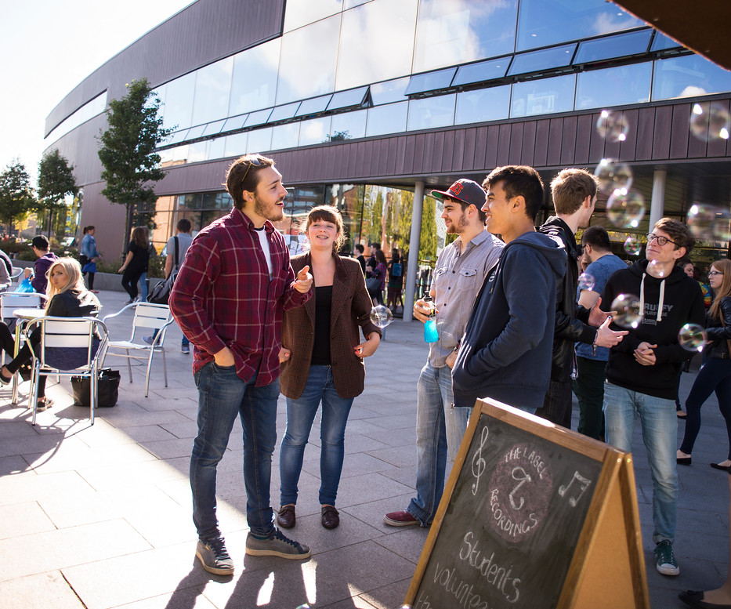
On Course
Bespoke social opportunities for THRIVE students only e.g. THRIVE cookery classes and THRIVE Student Fest event
Extra opportunities to meet up and head over together to events that already run on campus for the whole student population e.g. Walk with me, Saturday Social, Get Connected
Early access to ticketed university events such as IKEA trip and Careers Fair
Opportunity to set up your own society for further social opportunities

Slide 12

Coaching Conversations
Coaching is shown to have a powerful, positive impact on self-confidence, wellness, and performance.
Staff will be able to; be a listening ear, signpost you to relevant student services and work on goals and soft skills such as time management, organisation and emotional intelligence.
You are entitled to up to 2x 1-hour coaching conversations per term across first year, 6 in total. Limited number of spaces available so will be allocated on a first, come first serve basis.
Allocation will take place mid-October. You will be informed if you have been paired with a staff member and introduced to them by email.
We will have a waitlist for those who would like, and we can also signpost you to our student 1:1 coffee and catch-up service as an alternative too!

Slide 13
Career Enhancing Trips and Opportunities
Fully funded Trips to / visits to campus from businesses designed to;
Give you an insight into the wide variety of graduate jobs available in different areas
Hear employees from diverse backgrounds talk about their journeys to their careers
Learn vital employability skills such as networking

Slide 14

Matalan Trip

Slide 15
Enhanced Careers Support
Dedicated “Get Ahead” appointments with Careers advisors designated to support students from underrepresented backgrounds.
Can provide support to apply for on campus job roles such as Student Advisory Panel and Student Guide Roles and with completing expressions of interest for trips.

Slide 16
How Will I Know What’s On?
You will receive a newsletter outlining what events are on each month.
If a booking is required, the newsletter will include a link to the booking page.
We will also use your student email too

Slide 17
THRIVE Alumni Feedback
“It is a worthwhile programme to join as it gives you additional support and access to someone not related to your course to talk to”
“An extra support system there if you need it, but with no pressure”
“You can meet people with the same concerns, worries, and fears as you, people who have the same experiences or disabilities as you, gain help and support with navigating university as a student who is part of an underrepresented group, and more”
“Being part of Thrive gives you comfort to know that there is a network and system which has been created to help you and your needs, and you're not alone with what you are struggling with”

Slide 18

What Next?
Join online sessions throughout August-September
Keep an eye on your emails for newsletter outlining October – December events
Connect face to face at our social events
Thrive Coach allocation & first meeting in October

