Slide 1
Edge Hill University
Gender Pay Gap Reporting
for dataset: GPG March 2023

Slide 2


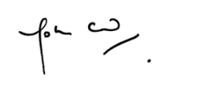
Introduction from the Vice Chancellor
Edge Hill has a long tradition of widening access to education and is committed to creating an inclusive work environment, addressing barriers to all forms of inequity and to providing all staff with equal opportunity. This commitment is not only central to our values, but also critical to the continued success of the University.
The University employs a substantial percentage of women in the first quartile - a consequence of our deliberate decision not to franchise-out any of our housekeeping and catering jobs, therefore guaranteeing that the least well-remunerated are paid in excess of the Living Wage Foundation recommendation and that all have access to a Defined Benefits Pension.
We remain committed to closing the gap by examining all factors that influence the pay gap and implementing identified strategies to render gender equality in pay a future reality. We have invested in the XpertHR Gapsquare platform to support us on that journey.
I can confirm that the information presented in the report is an honest, accurate and true representation of Edge Hill University’s position as of 31 March 2023.
Dr. John Cater – Vice Chancellor
Edge Hill University

Slide 3
What does it tell us?
The reports show the difference between the average earnings of men and women, expressed relative to men's earnings. If an organisation reports a gender pay gap, it does not mean women are paid less than men for doing the same job, but it does show that, on average, men occupy higher-paying roles than women.
A gender pay gap above zero represents that on average men earn more than women whereas a pay gap below zero indicates that women, on average, earn more than men.
Headlines about the gender pay gap tend to focus on the median figure, which ignores extremes and is therefore thought to be the most representative measure. It is, however, important to report all of these measures as each one can tell you something different about the underlying causes of the gender pay gap and each one can mask issues that another may highlight. If there is a big difference between an organisation’s mean and median pay gap, this indicates that the dataset is skewed – either by the presence of very low earners (making the mean lower than the median), or by a group of very high earners (making the mean bigger than the median).
Taking a ‘snapshot’ of this data on a set date, as required by regulation, creates a level playing field for all reporting organisations, however, the snapshot has the potential to mask the fluidity of gender pay gaps, which can fluctuate from month to month and across pay quartiles depending on changes to headcount.
What must we report?
Employers with more than 250 staff must report six different measures, based on a snapshot of pay data on a set date (usually 31 March in the previous year) as set out by the Government Equalities Office:
Median gender pay gap – the difference between the median hourly rate of pay of male full-pay relevant employees and that of female full-pay relevant employees
Mean gender pay gap – the difference between the mean hourly rate of pay of male full-pay relevant employees and that of female full-pay relevant employees
Median bonus gap – the difference between the median bonus pay paid to male relevant employees and that paid to female relevant employees
Mean bonus gap – the difference between the mean bonus pay paid to male relevant employees and that paid to female relevant employees
Bonus proportions – the proportions of male and female relevant employees who were paid bonus pay during the relevant period
Quartile pay bands – the proportions of male and female full-pay relevant employees in the lower, lower-middle, upper-middle and upper quartile pay bands

Slide 4
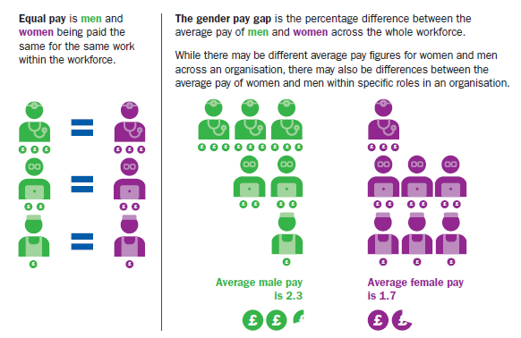


What is the difference between equal pay and the gender pay gap?
The gender pay gap isn’t the same as equal pay. Unequal pay is when women are paid less than men for doing the exact same work.
Equal pay has been a legal requirement since the Equality Act was introduced in 1970.
We conduct pay audits, routinely, have transparent pay frameworks and use the Higher Education Role Analysis (ECC) platform to ensure each of our roles are evaluated fairly.
We therefore remain confident that there is no evidence to suggest that there is an equal pay issue at Edge Hill University.

Slide 5
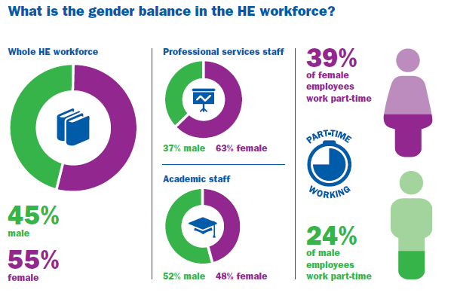
Who did we include?
As per legislative requirements, all Academic, Professional and Support Staff, Senior Managers, Professors and hourly paid Associate Tutors and non-academic workers have been included in this audit.
On the snapshot date, Edge Hill’s population of established, permanent, and fixed term staff, was 2438. Establishment only staff made up 1971 of our workforce.
64.1% (1264) of EHUs workforce on the snapshot date was made up of women in comparison to the HE sector average of 55%. The balance of part-time women (498) almost exactly mirrors the sector average at 39.4%.
35.9% (707) of EHUs workforce on the snapshot date was made up of men in comparison to the HE sector average of 45%. The balance of part-time men (140) is 4.2% below the sector average at 19.8%
Although establishment numbers remained relatively stable, there has been a further 7.43% decrease in the use of Associate Tutors compared to the previous year, in line with our ongoing commitment to tackling precarious contract arrangements.

Slide 6

EHU Summary

Slide 7
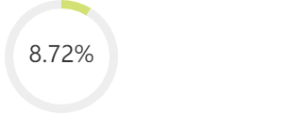
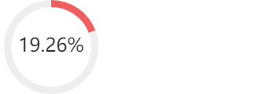
Women's mean bonus pay is 25.00% less
EHU Women's mean hourly rate is 8.72% less
Mean pay per hour for men: 22.47
Women's median bonus pay is 0.00% more
Mean pay per hour for women: 20.51
Proportion of women receiving bonus: 1.78%
Difference in pay: 1.96
Proportion of men receiving bonus: 3.86%
EHU Women's median hourly rate is 19.26% less
Median pay per hour for men: 20.05
Median pay per hour for women: 16.19
Difference in pay: 3.86
Group | Mean Pay Males | Mean Pay Females | Pay Gap (mean) | Pay Gap (median) | Percentage of Males | Percentage of Females | Contribution to Pay Gap
Lower quartile | 12.03 | 12.01 | 0.1% | 0.59% | 25.99% | 74.01% | -4.66%
Lower middle quartile | 15.07 | 14.90 | 1.17% | 0.02% | 31.25% | 68.75% | -1.72%
Upper middle quartile | 22.12 | 21.77 | 1.58% | 2.03% | 37.66% | 62.34% | 4.6%
Upper quartile | 35.29 | 36.26 | -2.77% | 0% | 40.36% | 59.64% | 10.5%

Slide 8
EHU Headline Figures
Pay

Slide 9


Mean Gender Pay Gap at EHU
2023: 8.72% - based on an hourly rate of ordinary pay
(Men £22.47 | Women £20.51).
Difference: £1.96
2022: 10.7% - based on an hourly rate of ordinary pay
(Men £21.26 | Women £18.98).
Difference: £2.28
2021: 9.9% - based on an hourly rate of ordinary pay
(Men £21.34 | Women £19.22).
Difference: £2.12
2020: 8.5% - based on an hourly rate of ordinary pay
(Men £20.53 | Women £18.78).
Difference: £1.75
At 8.72% the University’s Mean Gender Pay Gap remains well below the 14.2% sector average for the fifth consecutive year with some HEI’s reporting gaps above 30%. Equal Pay Day: your university’s gender pay gap | Times Higher Education (THE)

Slide 10
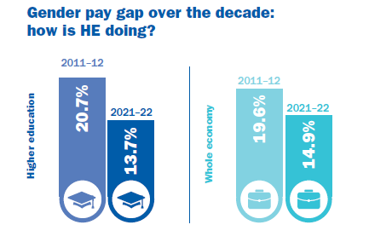
Median Gender pay gap at EHU
2023: 19.26% based on an hourly rate of ordinary pay
(Men £20.05 | Women £16.19).
Difference: £3.86
2022: 15.0% based on an hourly rate of ordinary pay
(Men £18.84 | Women £16.03).
Difference: £2.81
2021: 11.4% based on an hourly rate of ordinary pay
(Men £19.09 | Women £16.91).
Difference: £2.18
2020: 18.6% based on an hourly rate of ordinary pay
(Men £17.93 | Women £14.59).
Difference: £3.34
Over the last decade average median pay gaps have reduced significantly in the HE sector and the wider economy.
At 19.26% EHU is 5.56% above the 14.2% sector average, for the fifth consecutive year.

Slide 11
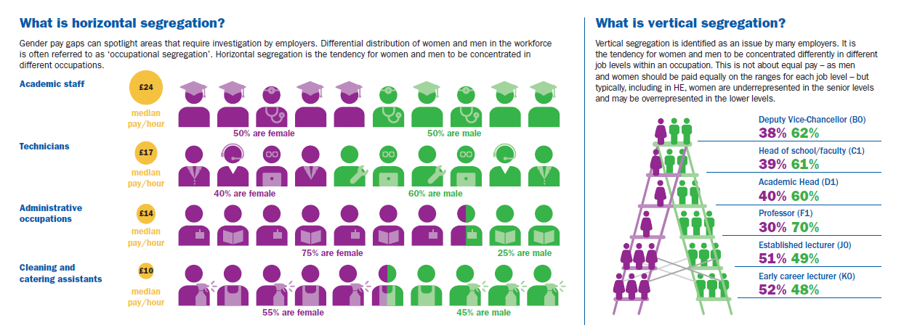

Slide 12
Detailed Report Analysis By Quartiles
The table below shows a division of our entire organisation into four groups of equal numbers, starting from the lowest-paid group (lower quartile) to the highest-paid group (upper quartile).
Group | Mean Pay Males | Mean Pay Females | Pay Gap (mean) | Pay Gap (median) | Percentage of Males | Percentage of Females | Contribution to Pay Gap
Lower quartile | 12.03 | 12.01 | 0.1% | 0.59% | 25.99% | 74.01% | -4.66%
Lower middle quartile | 15.07 | 14.90 | 1.17% | 0.02% | 31.25% | 68.75% | -1.72%
Upper middle quartile | 22.12 | 21.77 | 1.58% | 2.03% | 37.66% | 62.34% | 4.6%
Upper quartile | 35.29 | 36.26 | -2.77% | 0% | 40.36% | 59.64% | 10.5%
Slicing snapshot data up into quartiles allows us to explore the impact of horizontal and vertical segregation within EHU.
A contributing factor to our current position is the disproportionately high number of female staff employed in Facilities Management 79.7% against the sector average of 55%.
Our historic profile has meant that we have always been fortunate that female managers are well represented in both academic and professional support services reversing the sector trend in the middle and upper quartiles where we employ up to 68.75% female staff against sector averages of around 40%.
Another significantly skewing factor is that our two most senior leaders are men with exceptionally long service in post – which is understandably reflected in their renumeration.

Slide 13
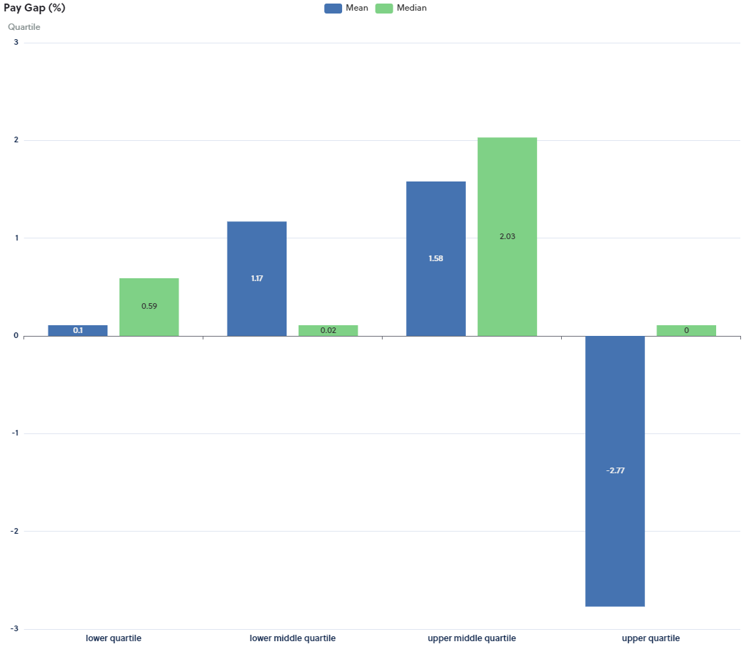
Pay Gaps by Quartiles
Each Quartile has its own separate pay gap, comparing them shows what levels of pay present the key imbalances and breaks down our organisation’s overall pay gap.
In the lower quartile we see positive gender pay gaps in both mean and median categories, indicating that, on average, men’s gross hourly earnings are higher than those of women.
At the opposite end of the scale, we see negative mean gender pay gap and zero median in the upper quartile indicating that, on average, women’s gross hourly earnings are higher than those of men.

Slide 14
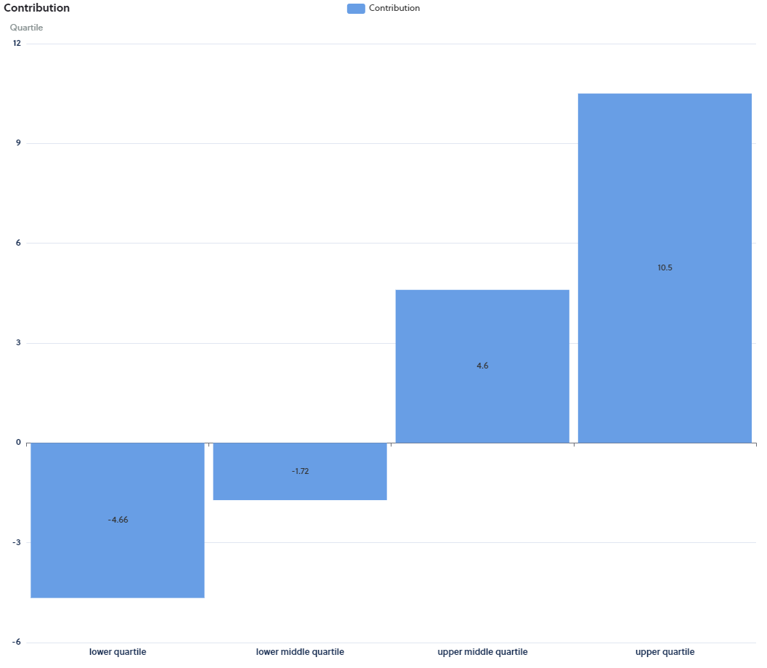
Contribution of Each Quartile to the Pay Gap
The Contribution section shows how each quartile contributes in percentage points towards our mean pay gap. We see that our two lower quartiles offer a negative contribution to the overall mean pay gap – where women earn more than men.
In contrast the upper quartiles present a positive contribution to the overall mean pay gap - this is to be expected where a significant volume of women occupy the lowest paid roles, and the highest paid roles are occupied by male senior leaders. This trend is currently reflected across the HE sector and in the general economy.

Slide 15
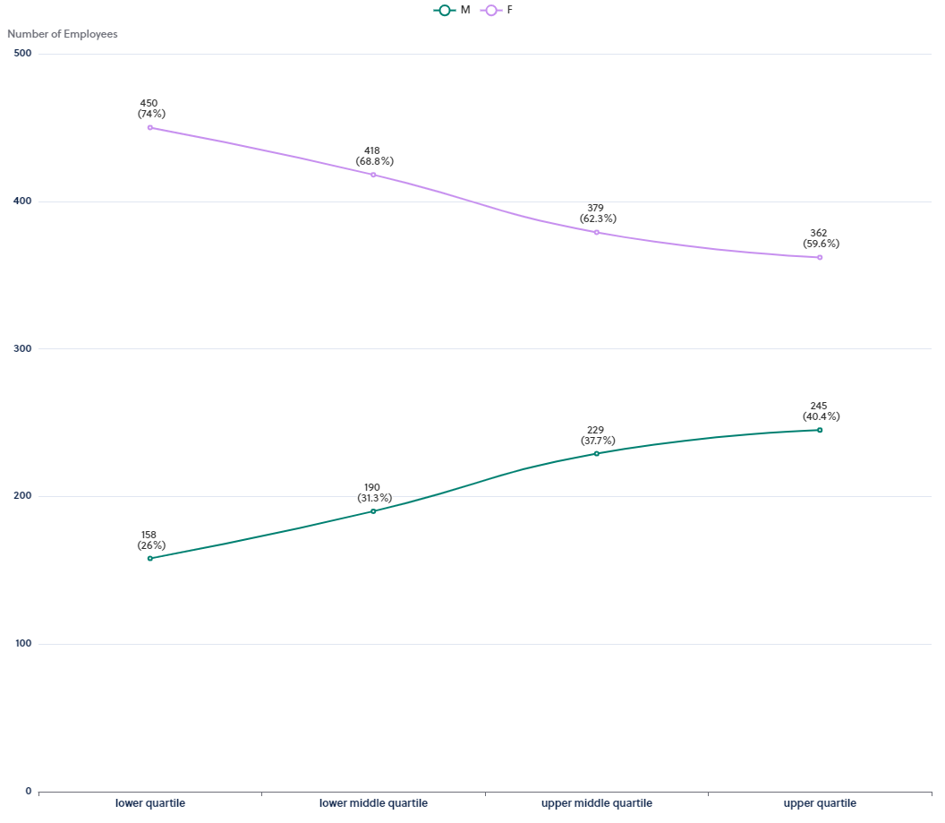
Workforce Representation by Quartiles
This graph shows the data broken down into 4 equally sized groups ranging from the lowest to the highest paid employees.
It shows the difference in the actual numbers of employees within the separate pay quartiles.
Positively, there is an overall higher proportion of women in the middle two quartiles where there is less evidence of gender pay gaps in both mean and median ranges.
The relative volume of women decreases as they move from the lower to upper pay quartiles. In contrast the relative volume of men increase as they move from the lower to upper quartiles. This trend is reflected in both the education sector and the general economy.

Slide 16
EHU Headline Figures
Bonus

Slide 17
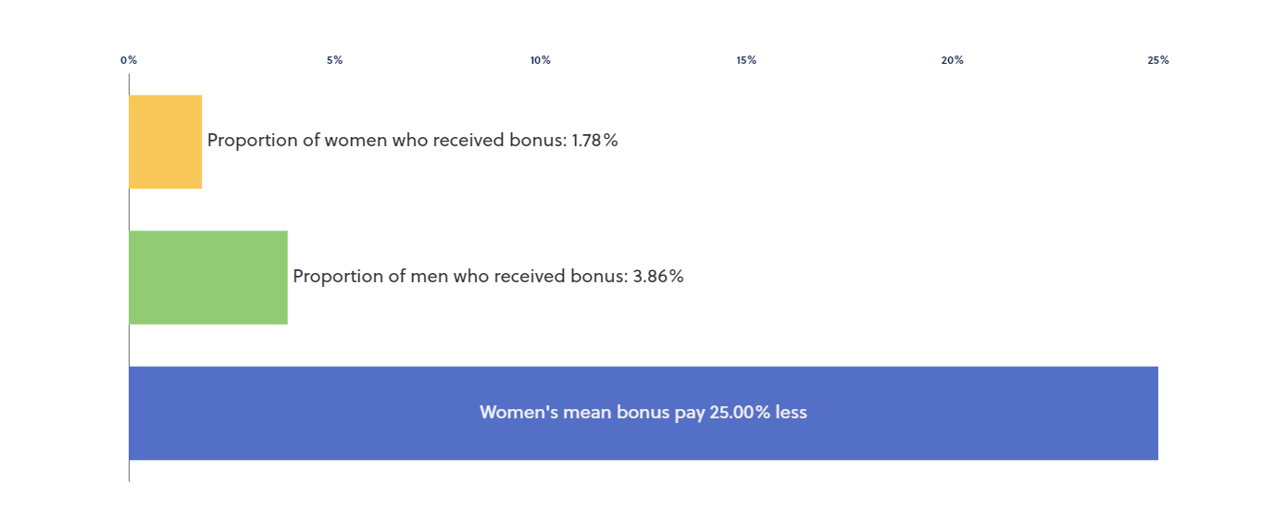
Bonus Pay Context
Non-consolidated, discretionary, bonus payments are only available to staff employed under Management or Professor terms and conditions at EHU. Bonus payments to these senior staff are awarded for outstanding or very good performance during the previous 12-month period.
The same bonus amounts are awarded to both men and women which is reflected clearly in our consistent 0% median pay gap figure. However, the number of payments will differ from year to year depending on the contribution each senior leader is judged to have made.
The Mean Gender Bonus Gap increased in 2023 by 25% compared to the previous year.
The proportion of eligible women receiving a bonus in 2023 decreased by 0.02% to 1.78% compared to the previous year.
The proportion of eligible men receiving a bonus in 2023 decreased by 0.48% compared to the previous year.
Bonus Pay Gap | 2023 | 2022 | 2021 | 2020
Mean | 25% more | 11.03% less | 45.9% less | 39.1% less
Median | 0.00% more | 0.00% more | 0.00% more | 0.00% more
Proportion of Women receiving | 1.78% | 1.8% | 1.5% | 1.5%
Proportion of Men receiving | 3.86% | 4.34% | 2.3% | 2.0%

Slide 18
Detailed Bonus Analysis By Quartiles
Group | Mean Bonus Pay Males | Mean Bonus Pay Females | Bonus Pay Gap (mean) | Bonus Pay Gap (median) | Percentage of Males | Percentage of Females | Contribution to Bonus Pay Gap
Lower quartile | 1177.78 | 900.00 | 23.58% | 52% | 40.91% | 59.09% | -0.99%
Lower middle quartile | 1250.00 | 1250.00 | 0% | 0% | 61.90% | 38.10% | 5.65%
Upper middle quartile | 1931.82 | 2159.09 | -11.76% | 0% | 50.00% | 50.00% | -2.26%
Upper quartile | 6250.00 | 3409.09 | 45.45% | 0% | 47.62% | 52.38% | 22.6%

Slide 19
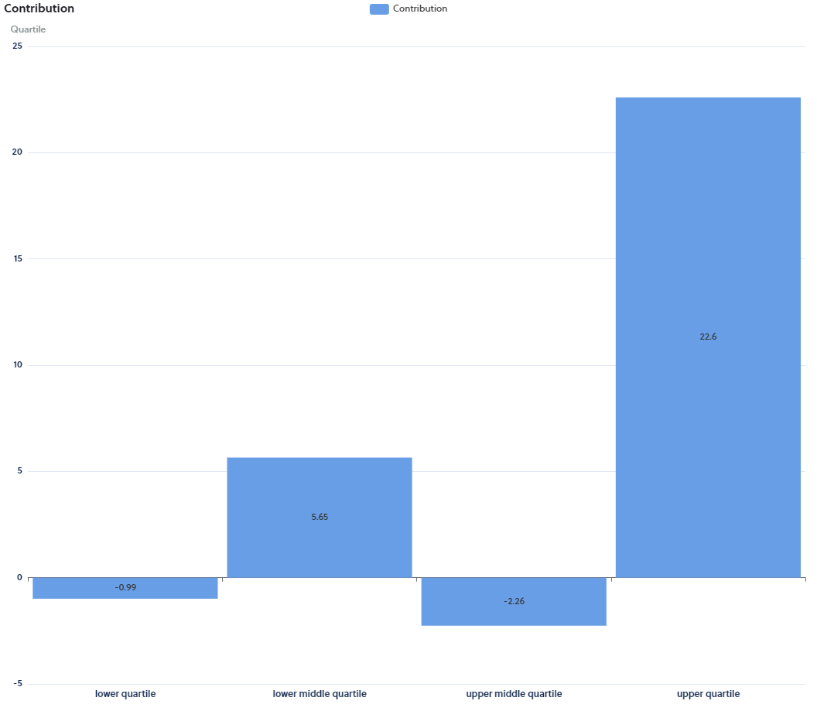
Contribution of Each Quartile to the Bonus Gap
The Contribution section shows how each Quartile contributes in percentage points towards our mean bonus pay gap.
Here we can see that the bonuses paid to men in the upper quartile have a 22.6.% contribution to the mean bonus pay gap. A reflection of the relative higher bonuses paid to our most senior male leaders.

Slide 20
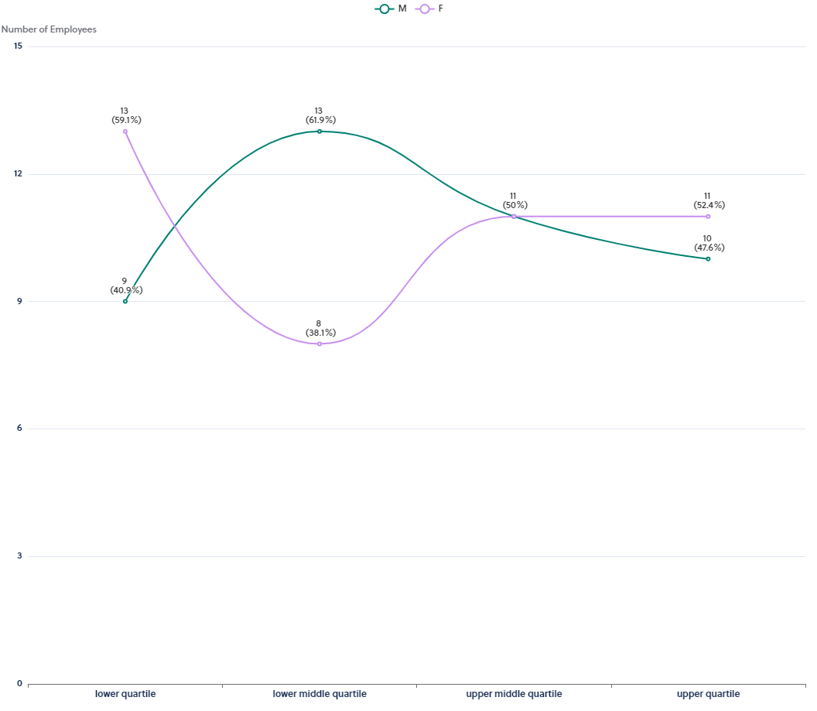
Bonus Workforce Representation by Quartiles
This graph shows the data broken down into 4 equally sized groups ranging from the lowest to the highest paid employees.
This graph simply shows the difference in the actual numbers of employees within the separate bonus pay quartiles.
More women than men occupy the lower and uppers quartiles.

Slide 21
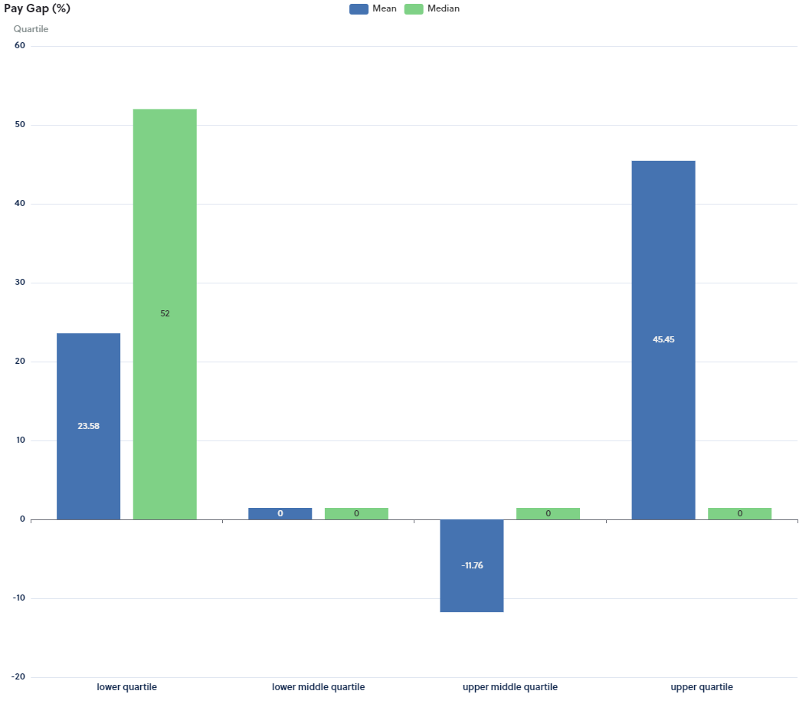
Bonus Gaps by Quartiles
Each Quartile has its own separate bonus pay gap, comparing them shows what levels of bonus pay present the key imbalances and breaks down our organisation’s overall bonus pay gap.
In the lower quartile we see positive gender pay gaps in both mean and median categories, indicating that, on average, men’s bonus awards are higher than those of women.
The upper and middle quartile presents a perfect median pay gap, indicating zero pay gap between the amount of bonus awarded to men and women.

Slide 22
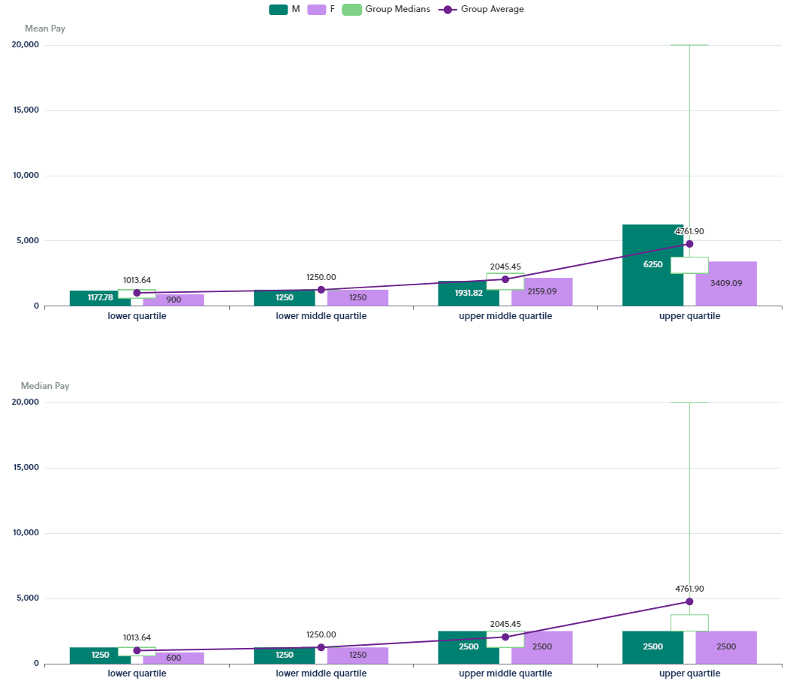
Bonus Ranges by Quartiles
This chart shows you the bonus pay ranges that provide the averages of Mean and Median for comparison.

Slide 23
Working to Close the Gap
Through Meaningful Actions

Slide 24
The University remains committed to gender equality and has a range of holistic short, medium and long-term strategies in place to achieve this.
Examples include but are not limited to:
Our People Plan, due for refresh in 2025, continues to promote a positive culture where staff feel engaged, recognised, valued, and encouraged and where they experience fairness and equity. We believe that a positive, inclusive culture enables success and competitive advantage and makes us an excellent place to work and study.
We continue to report progress against actions, annually, in the University People Report. The University has clear, externally benchmarked salary ranges in place for all job roles, which ensures that everyone is paid fairly for undertaking the same or similar role using the sector standard HE Role Analysis system (HERA) to support transparency and equity in grading our roles.
We continue to take appropriate measures to address any barriers to the attraction, recruitment, retention, development, progression and promotion of underrepresented staff e.g., embedding the use of Equality Impact Assessment (EqIA) improving EqIA training resources, analysis of staff data, and refining policy and practice when issues are identified.
We will continue to ensure that EDI training is fit for purpose, mandated to all staff upon appointment, and refreshed on a tri-annual basis.
We are committed to ensuring our family-friendly entitlements are in line with northern competitors and are extended to those with caring responsibilities where possible.
We will continue to encourage and support women to develop in their chosen careers and to engage with our improved coaching and mentoring provision and networks.
Through ACDIG, we will continue towards the embedding of local Work Allocation Models.

Slide 25
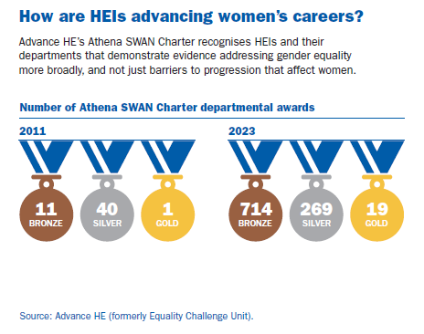
Edge Hill University remains committed to robust frameworks dedicated to the promotion of gender equality, retaining Bronze Athena Swan status in 2023.
Integrated work streams arising from these assessment processes are well established and are now governed institutionally, by a strategic Equality, Diversity and Inclusion Steering group and supported operationally by a newly established External Charters Manager and Associate Dean (with STEMM specialism)
The departments of the Faculty of Arts and Science are working towards achieving or applying for an Athena Swan Award. The Computer Science department is working towards Silver status. Additionally, the faculty is creating a specialized MA program on Women in Computer Science to promote and encourage more women to pursue careers in science, technology, engineering, mathematics, and medicine (STEMM).
We will improve academic PRD, identify trends in gender balance at each stage of the career life-cycle and identify actions that encourage women to be identified as ‘Category A submitted’ for the REF
We will monitor the recruitment process for our expanding STEMM portfolio, including GTAs, with particular attention to women’s representation.
Our International Women's Day program celebrates our university's history of promoting women's rights and inspiring the next generation of female leaders. We will use our Lessons in Leadership event to continue this legacy.

Slide 26
We will improve the support extended to staff returning from career breaks such as maternity leave – exploring new parents and breastfeeding peer support networks and Manager Toolkits.
We continue to listen to feedback and tailor long-term well-being initiatives and resources that support women of all ages and at all stages of their careers.
The establishment of a moderation framework has improved the transparency of performance bonuses for senior staff.
The establishment of an Honorarium and Acting Up Guidance has improved the fairness and equity in the use of temporary honorariums, acting-up arrangements and retention strategies for business-critical posts.
We will continue to use inclusive recruitment practices, particularly where we have areas of imbalance and underrepresentation at horizontal and vertical levels.
Working in partnership with Lancaster University, we will develop a first-in-sector – Menopause Toolkit to encourage an environment of openness and transparency where everyone can talk about, seek and provide support for colleagues experiencing menopause, perimenopause and menstruation.
We will continue to promote career development discussions, formal mentoring, sponsorship and network mechanisms for staff aspiring for progression and promotion.
We will pump prime a biannual Aroura Programme – using Knowledge Exchange expertise and reinvigorated alumni to mentor emerging cohorts.
We will review our equal pay auditing to ensure consistent practices for gender and other intersectional data during recruitment.
We are committed to working with UCEA on national Terms of Reference and, ultimately, action plans to reduce intersectional pay gaps, improve workload allocation models and reduce reliance on precarious contracts across the sector.

Slide 27
Thank you

