Slide 1
Edge Hill University
Gender Pay Gap Report
Snapshot: 31 March 2022

Slide 2


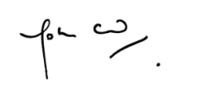
Introduction from the Vice Chancellor
Edge Hill has a long tradition of widening access to education and is committed to creating an inclusive work environment, addressing barriers to all forms of inequity and to providing all staff with equal opportunity. This commitment is not only central to our values, but also critical to the continued success of the University.
The University employs a substantial percentage of women in the first quartile - a consequence of our deliberate decision not to franchise-out any of our housekeeping and catering jobs, therefore guaranteeing that the least well-remunerated are paid in excess of the Living Wage Foundation recommendation and that all have access to a Defined Benefits Pension.
We remain committed to closing the gap by examining all factors that influence the pay gap and implementing identified strategies to render gender equality in pay a future reality. We have invested in the XpertHR Gapsquare platform to support us on that journey.
I can confirm that the information presented in the report is an honest, accurate and true representation of Edge Hill University’s position as of 31 March 2022.
Dr. John Cater – Vice Chancellor
Edge Hill University

Slide 3
What does it tell us?
The reports show the difference between the average earnings of men and women, expressed relative to men's earnings. If an organisation reports a gender pay gap, it does not mean women are paid less than men for doing the same job, but it does show that, on average, men occupy higher-paying roles than women.
A gender pay gap above zero represents that on average men earn more than women whereas a pay gap below zero indicates that women, on average, earn more than men.
Headlines about the gender pay gap tend to focus on the median figure, which ignores extremes and is therefore thought to be the most representative measure. It is, however, important to report all of these measures as each one can tell you something different about the underlying causes of the gender pay gap and each one can mask issues that another may highlight. If there is a big difference between an organisation’s mean and median pay gap, this indicates that the dataset is skewed – either by the presence of very low earners (making the mean lower than the median), or by a group of very high earners (making the mean bigger than the median).
Taking a ‘snapshot’ of this data on a set date, as required by regulation, creates a level playing field for all reporting organisations, however, the snapshot has the potential to mask the fluidity of gender pay gaps, which can fluctuate from month to month and across pay quartiles depending on changes to headcount.
What must we report?
Employers with more than 250 staff must report six different measures, based on a snapshot of pay data on a set date (usually 31 March in the previous year) as set out by the Government Equalities Office:
Median gender pay gap – the difference between the median hourly rate of pay of male full-pay relevant employees and that of female full-pay relevant employees
Mean gender pay gap – the difference between the mean hourly rate of pay of male full-pay relevant employees and that of female full-pay relevant employees
Median bonus gap – the difference between the median bonus pay paid to male relevant employees and that paid to female relevant employees
Mean bonus gap – the difference between the mean bonus pay paid to male relevant employees and that paid to female relevant employees
Bonus proportions – the proportions of male and female relevant employees who were paid bonus pay during the relevant period
Quartile pay bands – the proportions of male and female full-pay relevant employees in the lower, lower-middle, upper-middle and upper quartile pay bands

Slide 4
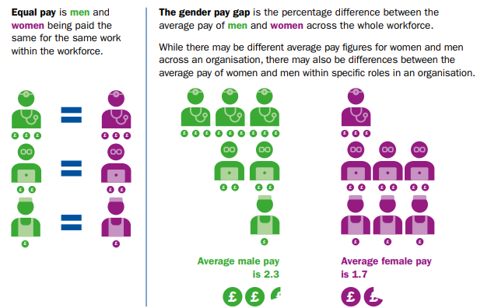


What is the difference between equal pay and the gender pay gap?
The gender pay gap isn’t the same as equal pay. Unequal pay is when women are paid less than men for doing the exact same work.
Equal pay has been a legal requirement since the Equality Act was introduced in 1970.
We conduct pay audits, routinely, have transparent pay frameworks and use the Higher Education Role Analysis (ECC) platform to ensure each of our roles are evaluated fairly.
We therefore remain confident that there is no evidence to suggest that there is an equal pay issue at Edge Hill University.

Slide 5
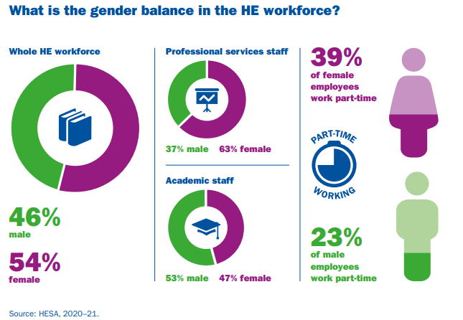
Who did we include?
Who did we include?
As per legislative requirements, all Academic, Professional and Support Staff, Senior Managers, Professors and hourly paid Associate Tutors and non-academic workers have been included in this audit.
On the snapshot date, Edge Hill’s population of established, permanent, and fixed term staff, was 2260. Establishment only staff made up 1838 of our workforce.
63.4% (1166) of EHUs workforce on the snapshot date was made up of women in comparison to the HE sector average of 54%. The balance of part-time women (464) almost exactly mirrors the sector average at 39.7%.
36.5% (672) of EHUs workforce on the snapshot date was made up of men in comparison to the HE sector average of 46%. The balance of part-time men (146) sat just 1.27% below the sector average at 21.73%
Although establishment numbers remained relatively stable, there was a 24% reduction in Associate Tutor usage and a 69% reduction in casual staff compared to the year previous in line with a sector wide commitment to tackling precarious contract arrangements.

Slide 6

EHU Summary

Slide 7
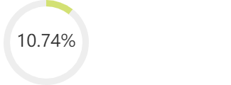
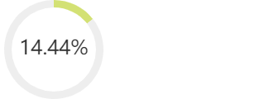
- SUMMARY
EHU Women's mean hourly rate is 10.74% less
Women’s mean bonus pay is 11.03% less
Women’s median bonus pay is 0.00%
Proportion of women receiving bonuses: 1.79%
Proportion of men receiving bonuses: 4.34%
Mean pay per hour for men: 21.28
Mean pay per hour for women: 19.00
Difference in pay: 2.29
EHU Women's median hourly rate is 14.44% less
Median pay per hour for men: 18.84
Median pay per hour for women: 16.12
Difference in pay: 2.72
Group | Mean Pay Males | Mean Pay Females | Pay Gap (mean) | Pay Gap (median) | Percentage of Males | Percentage of Females | Contribution to Pay Gap
Lower quartile | 10.53 | 10.80 | -2.53% | -4.75% | 26.02% | 73.98% | -4.98%
Lower middle quartile | 13.97 | 13.79 | 1.26% | 5.07% | 33.81% | 66.19% | -0.27%
Upper middle quartile | 20.54 | 20.30 | 1.2% | 0% | 37.52% | 62.48% | 3.54%
Upper quartile | 34.97 | 33.63 | 3.84% | 3.42% | 40.53% | 59.47% | 12.46%

Slide 8
EHU Headline Figures
Pay

Slide 9


Mean Gender Pay Gap at EHU
2022: 10.7% - based on an hourly rate of ordinary pay
(Men £21.26 | Women £18.98).
Difference: £2.28
2021: 9.9% - based on an hourly rate of ordinary pay
(Men £21.34 | Women £19.22).
Difference: £2.12
2020: 8.5% - based on an hourly rate of ordinary pay
(Men £20.53 | Women £18.78).
Difference: £1.75
At 10.7% the University’s Mean Gender Pay Gap remains well below the 12.3% sector average, for the fourth consecutive year.

Slide 10
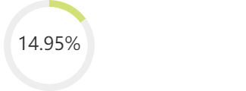
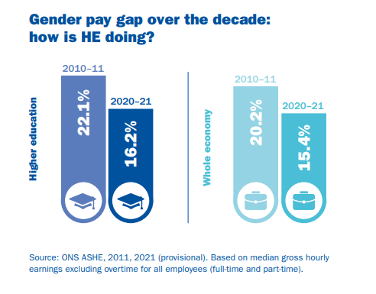
Median Gender pay gap at EHU
2022: 15.0% based on an hourly rate of ordinary pay
(Men £18.84 | Women £16.03).
Difference: £2.81
2021: 11.4% based on an hourly rate of ordinary pay
(Men £19.09 | Women £16.91).
Difference: £2.18
2020: 18.6% based on an hourly rate of ordinary pay
(Men £17.93 | Women £14.59).
Difference: £3.34
Over the last decade average median pay gaps have reduced significantly in the HE sector and the wider economy.
At 14.9% EHU remains comfortably below the 16.2% sector average, for the fourth consecutive year.

Slide 11
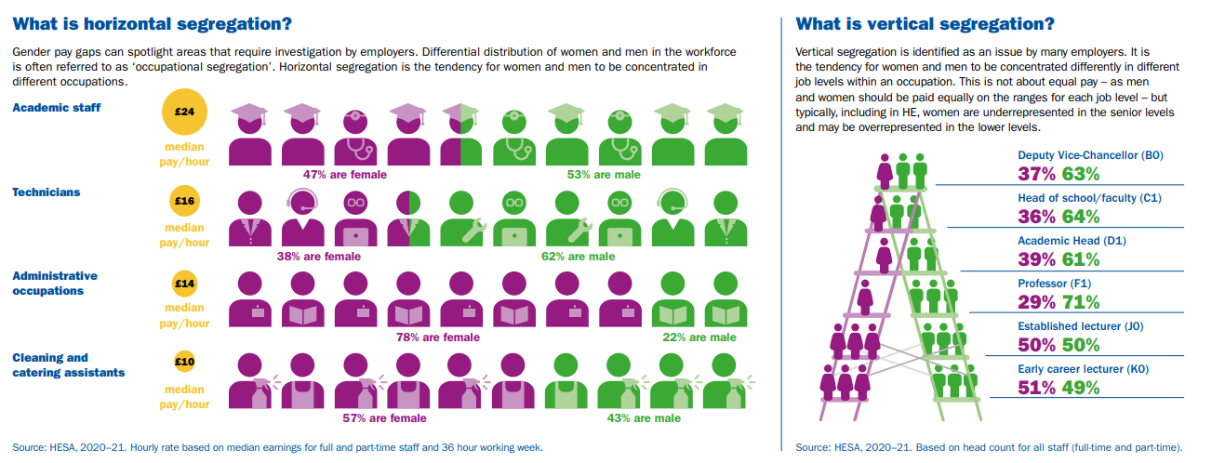

Slide 12
Detailed Report Analysis By Quartiles
The table below shows a division of our entire organisation into four groups of equal numbers, starting from the lowest-paid group (lower quartile) to the highest-paid group (upper quartile).
Group | Mean Pay Males | Mean Pay Females | Pay Gap (mean) | Pay Gap (median) | Percentage of Males | Percentage of Females | Contribution to Pay Gap
Lower quartile | 10.48 | 10.76 | -2.62% | -2.53% | 26.02% | 73.98% | -4.98%
Lower middle quartile | 13.94 | 13.78 | 1.12% | 3.88% | 33.63% | 66.37% | -0.42%
Upper middle quartile | 20.48 | 20.30 | 0.86% | 0% | 37.52% | 62.48% | 3.45%
Upper quartile | 34.91 | 33.65 | 3.63% | 1.4% | 40.71% | 59.29% | 12.69%
Slicing snapshot data up into quartiles allows us to explore the impact of horizontal and vertical segregation within EHU.
A contributing factor to our current position is the disproportionately high number of female staff employed in Facilities Management 73.9% against the sector average of 57%.
Our historic profile has meant that we have always been fortunate that female managers are well represented in both academic and professional support services reversing the sector trend in the middle and upper quartiles where we employ up to 66.3% female staff against sector averages of around 40%
Another significantly skewing factor is that our two most senior leaders are men with exceptionally long service in post – which is understandably reflected in their renumeration.

Slide 13
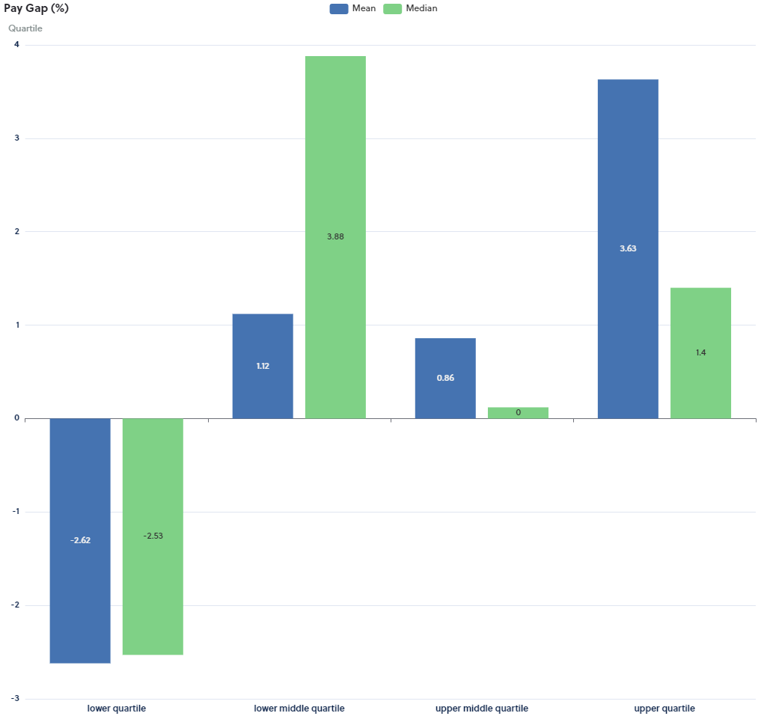
Each Quartile has its own separate pay gap, comparing them shows what levels of pay present the key imbalances and breaks down our organisation’s overall pay gap.
In the lower quartile we see negative gender pay gaps in both mean and median categories, indicating that, on average, women’s gross hourly earnings are higher than those of men.
At the opposite end of the scale, we see positive gender pay gaps in both mean and median categories, indicating that, on average, men’s gross hourly earnings are higher than those of women.
The upper middle quartile presents a perfect median pay gap and a 0.8% mean pay gap, indicating zero and extremely narrow pay gaps between men and women.
Pay Gaps by Quartiles

Slide 14
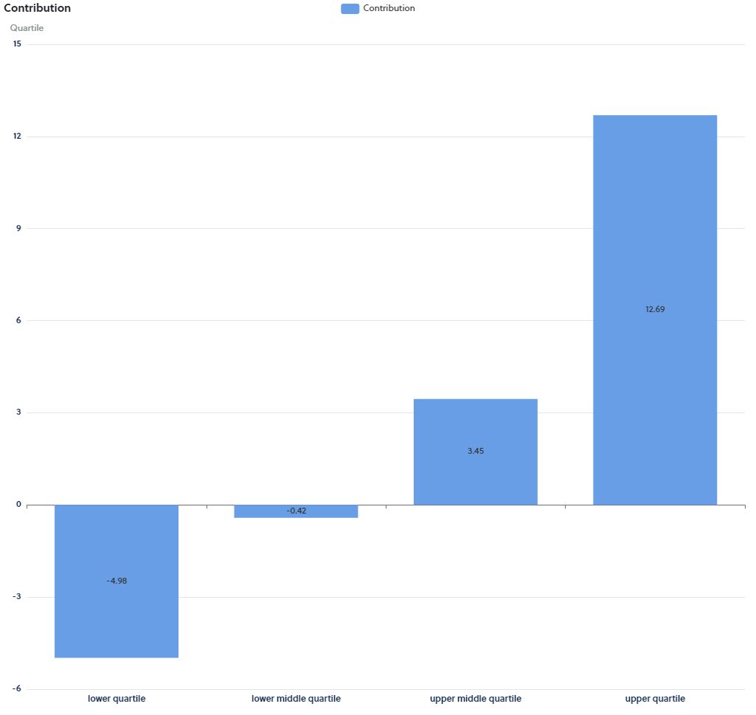
The Contribution section shows how each quartile contributes in percentage points towards our mean pay gap. We see that our two lower quartiles offer a negative contribution to the overall mean pay gap – where women earn more than men.
In contrast the upper quartiles present a positive contribution to the overall mean pay gap - this is to be expected where a significant volume of women occupy the lowest paid roles, and the highest paid roles are occupied by male senior leaders. This trend is currently reflected across the HE sector and in the general economy.
Contribution of Each Quartile to the Pay Gap

Slide 15
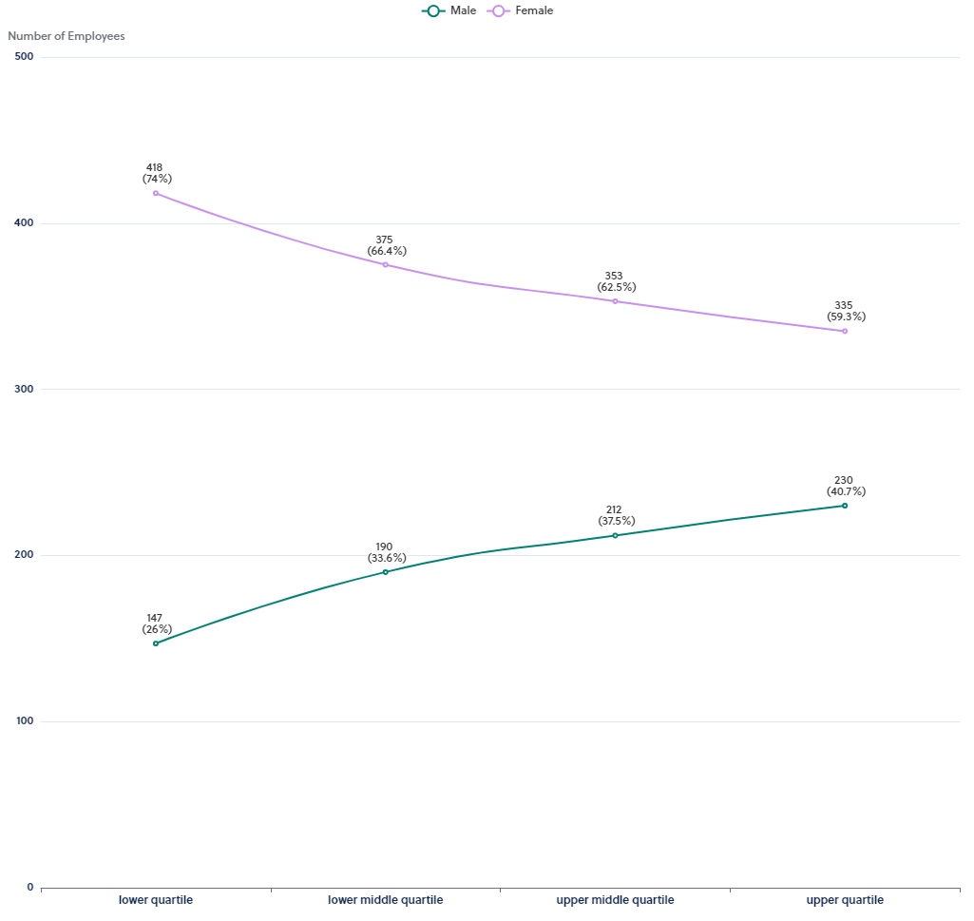
This graph shows the data broken down into 4 equally sized groups ranging from the lowest to the highest paid employees.
It shows the difference in the actual numbers of employees within the separate pay quartiles.
Positively, there is an overall higher proportion of women in the middle two quartiles where there is less evidence of gender pay gaps in both mean and median ranges.
The relative volume of women decreases as they move from the lower to upper pay quartiles. In contrast the relative volume of men increase as they move from the lower to upper quartiles. This trend is reflected in both the education sector and the general economy.
Workforce Representation by Quartiles

Slide 16
EHU Headline Figures
Bonus

Slide 17
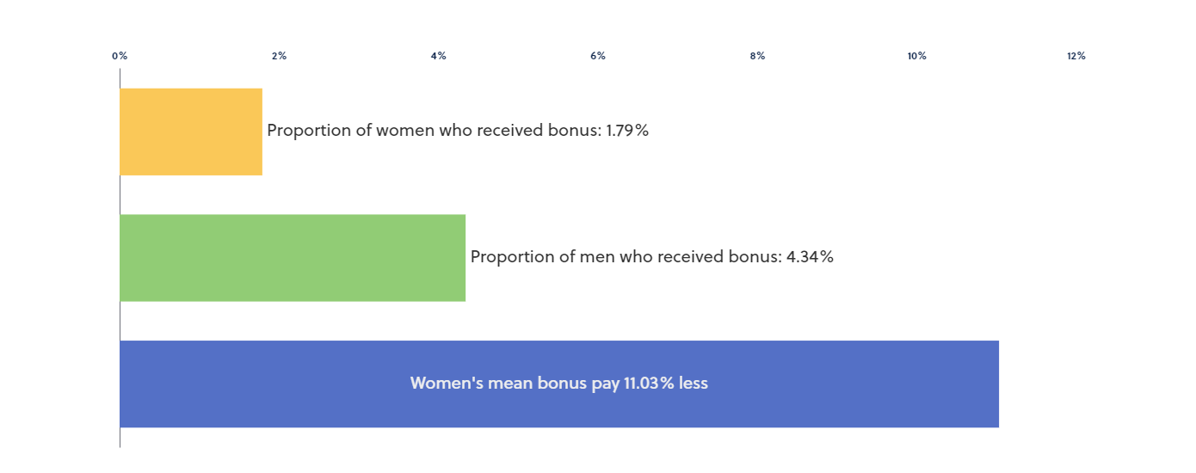
Bonus Pay Context
Bonus Pay Gap | 2022 | 2021 | 2020
Mean | 11.03% less | 45.9% less | 39.1% less
Median | 0.00% more | 0.00% more | 0.00% more
Proportion of Women receiving | 1.8% | 1.5% | 1.5%
Proportion of Men receiving | 4.34% | 2.3% | 2.0%
Non-consolidated, discretionary, bonus payments are only available to staff employed under Management or Professor terms and conditions at EHU. Bonus payments to these senior staff are awarded for outstanding or very good performance during the previous 12 month period.
The same bonus amounts are awarded to both men and women which is reflected clearly in our consistent 0% median pay gap figure. However, the number of payments will differ from year to year depending on the contribution each senior leader is judged to have made.
The Mean Gender Bonus Gap narrowed in 2022 by 34.87% compared to the previous year.
The proportion of eligible women receiving a bonus in 2022 increased by 0.3% to 1.8% compared to the previous two years.
The proportion of eligible men receiving a bonus in 2022 increased by 2.04% compared to 2021 and 2.34% compared to 2020

Slide 18
Detailed Bonus Analysis By Quartiles
Group | Mean Bonus Pay Males | Mean Bonus Pay Females | Bonus Pay Gap (mean) | Bonus Pay Gap (median) | Percentage of Males | Percentage of Females | Contribution to Bonus Pay Gap
Lower quartile | 107.89 | 416.67 | -286.18% | -1100% | 86.36% | 13.64% | 0.57%
Lower middle quartile | 1177.78 | 1087.50 | 7.67% | 0% | 42.86% | 57.14% | -6.32%
Upper middle quartile | 1500.00 | 1704.55 | -13.64% | 0% | 47.62% | 52.38% | -9.34%
Upper quartile | 6666.67 | 2500.00 | 62.5% | 0% | 42.86% | 57.14% | 26.12%

Slide 19
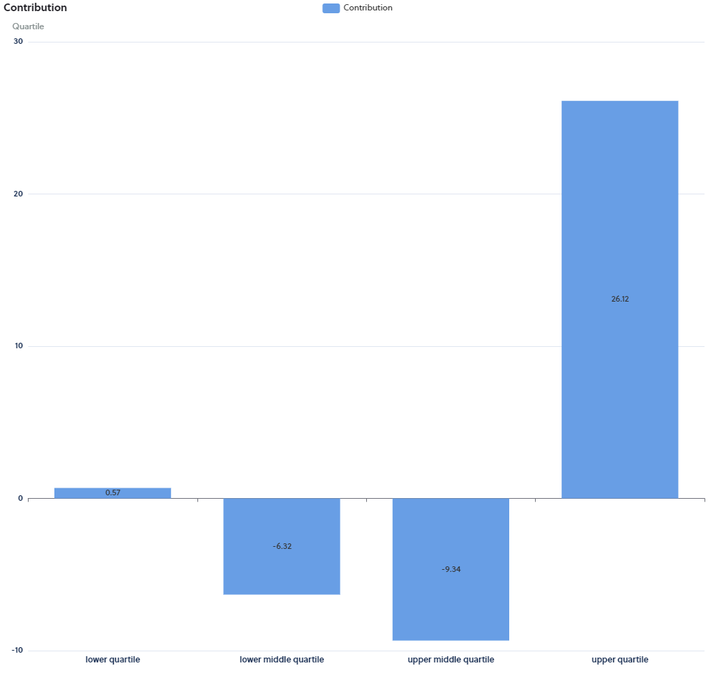
The Contribution section shows how each Quartile contributes in percentage points towards our mean bonus pay gap.
Here we can see that the bonuses paid to men in the upper quartile have a 26.12% contribution to the mean bonus pay gap. A reflection of the relative higher bonuses paid to our most senior male leaders.
We see that the greater number of women receiving bonuses in the middle quartiles counteract the mean bonus gap by -15.66% collectively.
Contribution of Each Quartile to the Bonus Gap

Slide 20
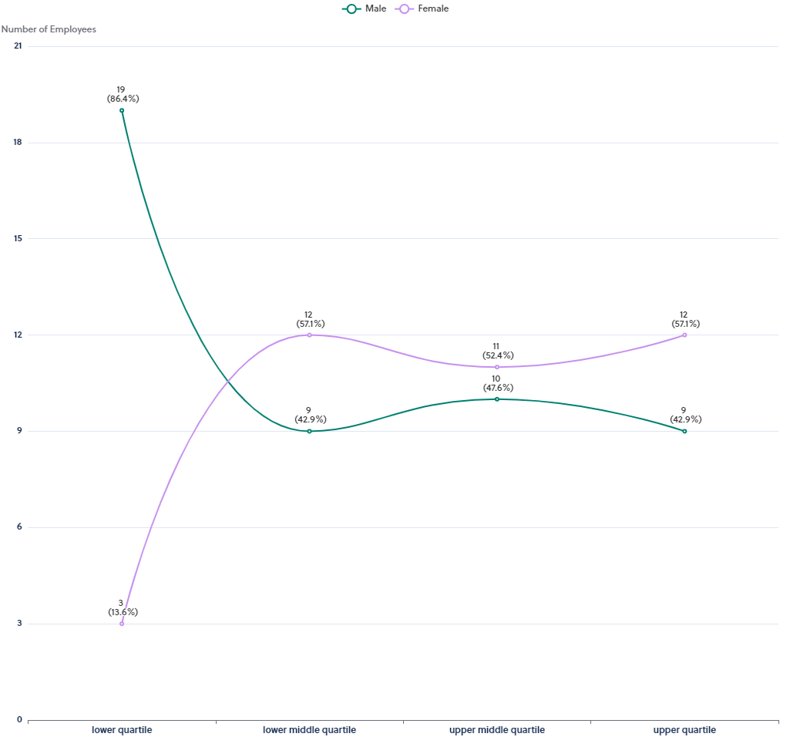
This graph shows the data broken down into 4 equally sized groups ranging from the lowest to the highest paid employees.
This graph simply shows the difference in the actual numbers of employees within the separate bonus pay quartiles for eligible senior Managers and Professors.
More men than women occupy the lowest quartile and more women than men occupy the upper quartile.
Bonus Workforce Representation by Quartiles

Slide 21
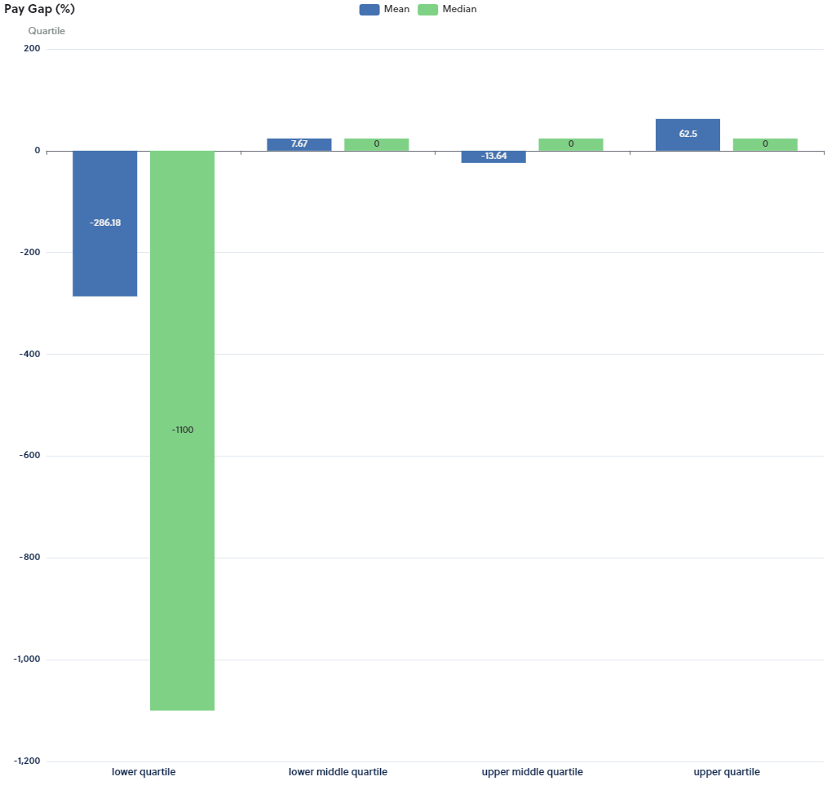
Each Quartile has its own separate bonus pay gap, comparing them shows what levels of bonus pay present the key imbalances and breaks down our organisation’s overall bonus pay gap.
In the lower quartile we see negative gender pay gaps in both mean and median categories, indicating that, on average, women’s bonus awards are higher than those of men.
At the opposite end of the scale, we see relatively small positive gender bonus pay gaps in the mean category, indicating that, on average, men’s bonus awards are slightly higher than those awarded to women.
The upper and middle quartile presents a perfect median pay gap, indicating zero pay gap between the amount of bonus awarded to men and women.
Bonus Gaps by Quartiles

Slide 22
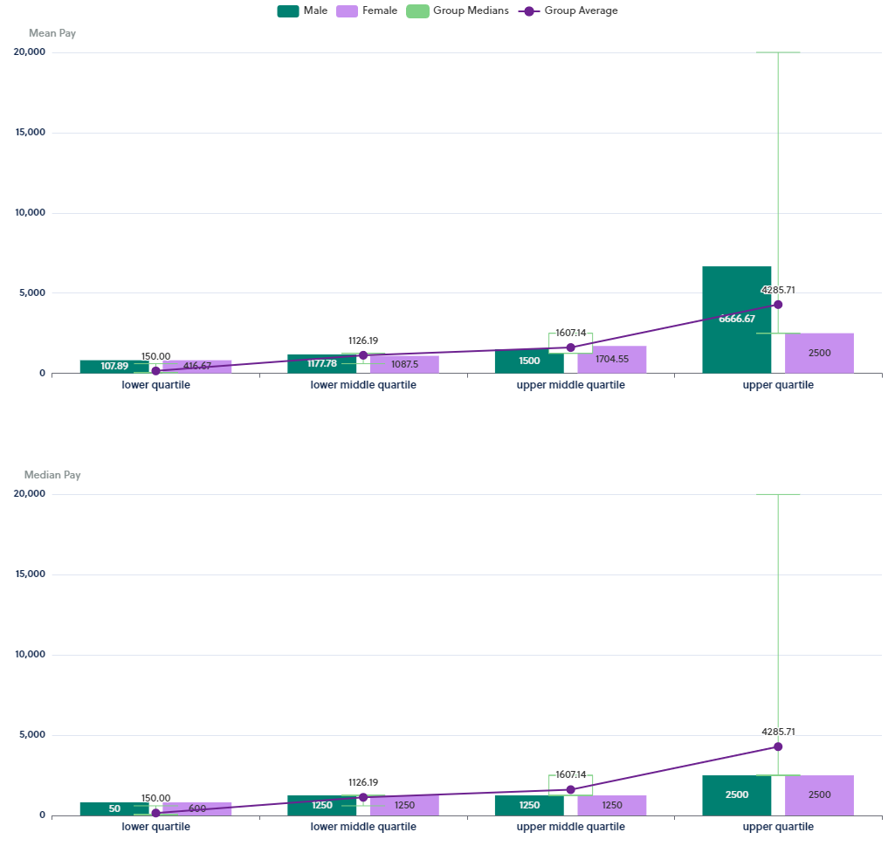
This chart shows you the bonus pay ranges that provide the averages of Mean and Median for comparison.
Bonus Ranges by Quartiles

Slide 23
Working to Close the Gap
Through Meaningful Actions

Slide 24
The University remains committed to gender equality and has a range of holistic short, medium and long-term strategies in place to achieve this.
Examples include but are not limited to:
Our People Strategy 2020-2025 continues to promote a positive culture where staff feel engaged, recognised, valued, encouraged, and where they experience fairness and equity. We believe that a positive, inclusive culture enables success, competitive advantage and makes us an excellent place to work and study.
We continue to report progress against actions, annually, in the University People Report. The University has clear, externally benchmarked salary ranges in place for all job roles, which ensures that everyone is paid fairly for undertaking the same or similar role using the sector standard HE Role Analysis system (HERA) to support transparency and equity in grading our roles.
We will continue to undertake equality impact assessments (EqIA), take appropriate measures to address any barriers to the attraction, recruitment, retention, development, progression and promotion of underrepresented staff e.g., refining guidance, policy and practice when issues arise as a result of them.
Directed by the strategic EDI action plan, we continue to embed responsibility for inclusive practice in all roles within the University and will deliver this objective through our Performance Review and Development process 2023-24.
We will continue to ensure that EDI training is fit for purpose and mandated to all staff upon appointment and refreshed on a tri-annual basis.
We are committed to ensuring our family friendly policies are in line with sector best practice and are extended to those with caring responsibilities
We will continue to encourage and support women to develop in their chosen careers and to engage with career enhancing, coaching and mentoring where appropriate
Through ACDIG, we will continue to develop and implement local Work Allocation Models that encourage transparency and fairness in the distribution of contractual responsibilities across our academic community

Slide 25
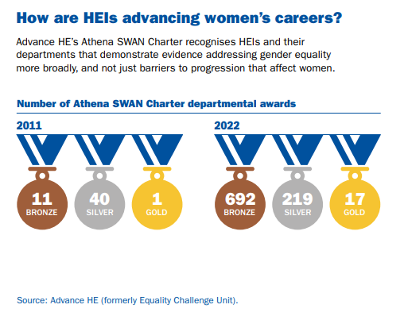
Edge Hill University remains committed to robust frameworks dedicated to the promotion of gender equality, retaining Bronze Athena Swan status in 2019 and HR Excellence in Research Award status in 2022.
Integrated work streams arising from these assessment processes are well established and are now governed institutionally, by a strategic Equality, Diversity and Inclusion Steering group and supported operationally by a newly established External Charters Manager and senior academic leader.
We are proud of the positive trajectory made by sector over the last decade and closer to home, our biggest academic faculty (the Faculty of Arts and Science) has made a commitment for all departments within it, to submit successful Athena Swan application by 2025
We will use a CEDAR Survey in 2023 and use feedback from our academics to shape a supportive Research Leadership Development Programme
We will improve academic PRD, identify trends in gender balance at each stage of the career life-cycle and identify actions that encourage women to be identified as ‘Category A submitted’ for the REF
We will monitor the recruitment process for our expanding STEMM portfolio, including GTAs, with particular attention to women’s representation.

Slide 26
We will improve the support extended to staff returning from career breaks such as maternity leave – exploring new parents and breastfeeding peer support networks and Manager Toolkits.
We continue to listen to feedback and tailor long term wellbeing initiatives and resources that support women of all ages and at all stages of their career.
We will explore ways in which we can improve the transparency of performance bonuses for senior staff
We will explore the fairness and equity in temporary honorariums, acting up arrangements and retention strategies for business critical posts.
We will continue to use inclusive recruitment practices, particularly where we have areas of imbalance and underrepresentation at horizontal and vertical levels.
We will continue to encourage an environment of openness and transparency where everyone can talk about, seek and provide support for colleagues experiencing menopause, perimenopause and menstruation.
We will continue to promote career development discussions, formal mentoring, sponsorship and network mechanisms for staff aspiring for progression and promotion.
We will continue to encourage and support women to undertake the Aurora Programme – a programme specifically aimed at women with leadership aspirations on a biannual basis.
We are committed to working with UCEA on national Terms of Reference and ultimately, action plans, to reduce intersectional pay gaps, improve workload allocation models and reduce reliance on precarious contracts across the sector.

Slide 27
Thank you

