Slide 1


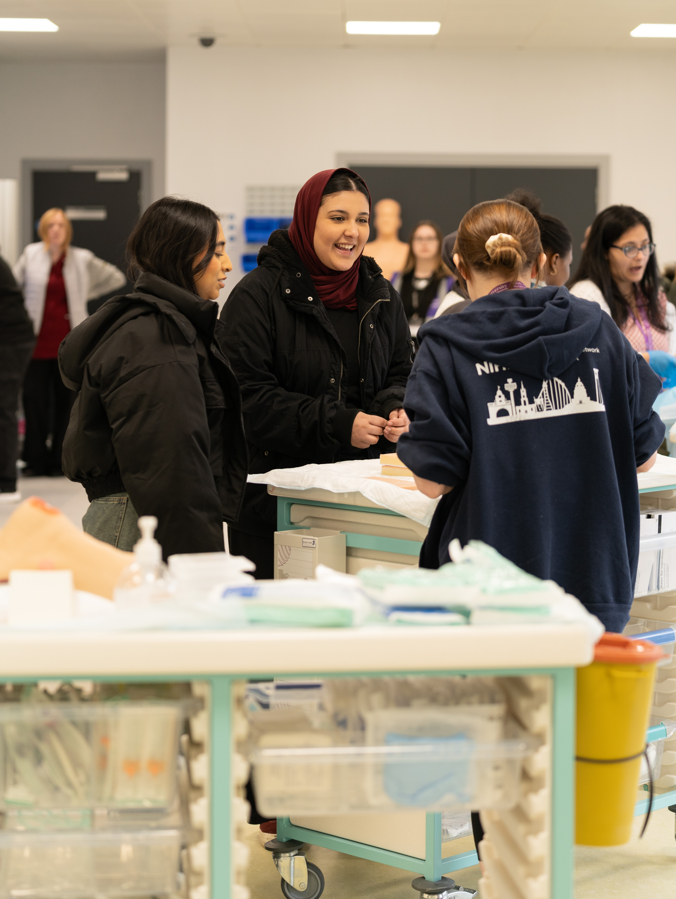
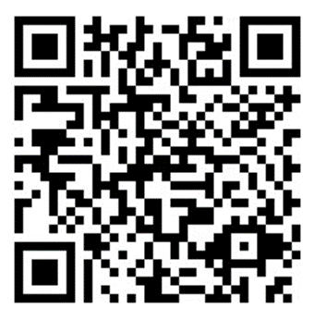
Diversity Access Programme
For Black, Asian & Minority Ethnic Year 12/1st Year Students
Event 1a
Event 1b
Event 2
Event 3
You and
Uni
November 2024
In sixth form/college session
Explore belonging at university
Form friendships with others on the programme
Session for Supporters
Wednesday 27th November 2024
Online session
Advice around university
Information about the Diversity Access Programme
On Campus Connections
Wednesday 5th March 2025
On campus event
Academic tasters
Society insights
Student life experiences
Choose your Future
May 2025
In sixth form/college session
Session directed by you
Guidance for the right point of your journey
If you attend all events, you will receive an 8-point UCAS offer reduction on application to Edge Hill on completion of the programme. This reduced offer excludes Medicine.
All of our access programmes are completely free and include a free lunch on campus visits. We also support travel costs to enable you to attend.
Scan to express your interest

Slide 2
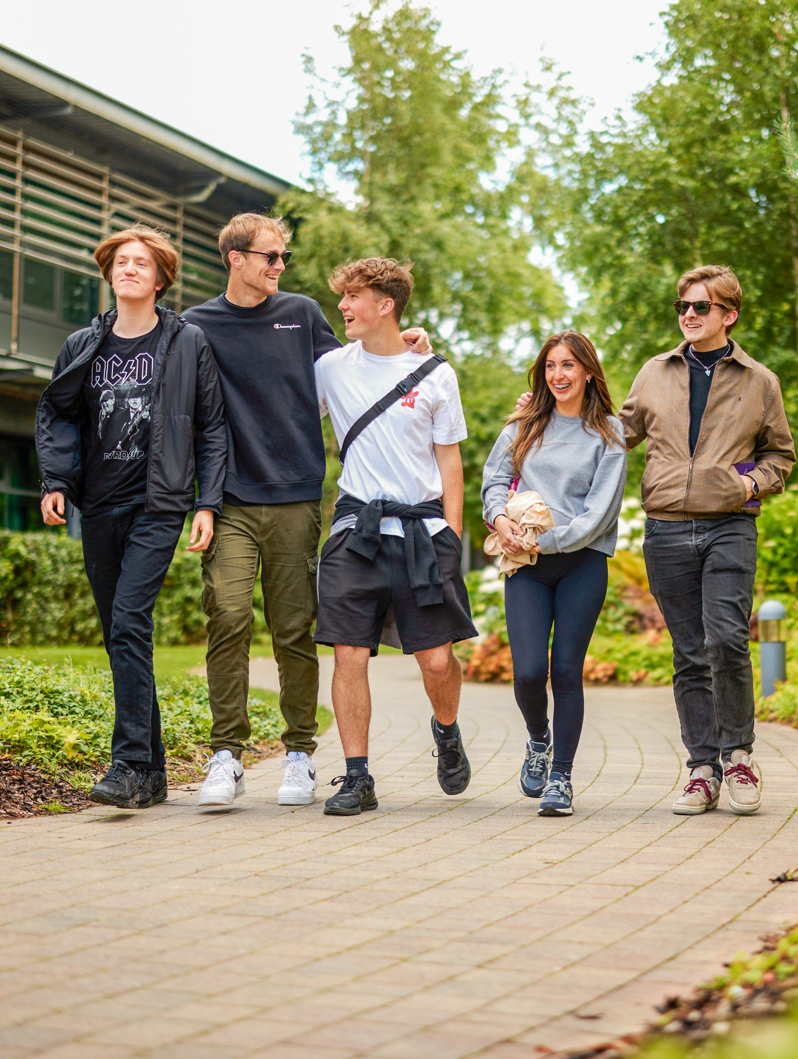
Ignite Access Programme
For Year 12/1st Year Students who have received free school meals in the past 6 years
Event 1a
Event 1b
Event 2
Event 3
Is HE
for Me?
November 2024
In sixth form/college session
Explore your educational future
Form friendships with others on the programme
Session for Supporters
Wednesday 4th December 2024
Online session
Advice around university
Information about the Ignite Access Programme
Futures & Foundations
Wednesday 12th March 2025
On campus event
Learn about alumni destinations
Explore budgeting and managing your money
Prep for
Success
April 2025
In sixth form/college session
Session preparing you for success in Year 13
Guidance on your next steps
Students on the programme will also receive tailored communications informed by current students and expert staff.
All of our access programmes are completely free and include a free lunch on campus visits. We also support travel costs to enable you to attend.
Scan to express your interest

Slide 3
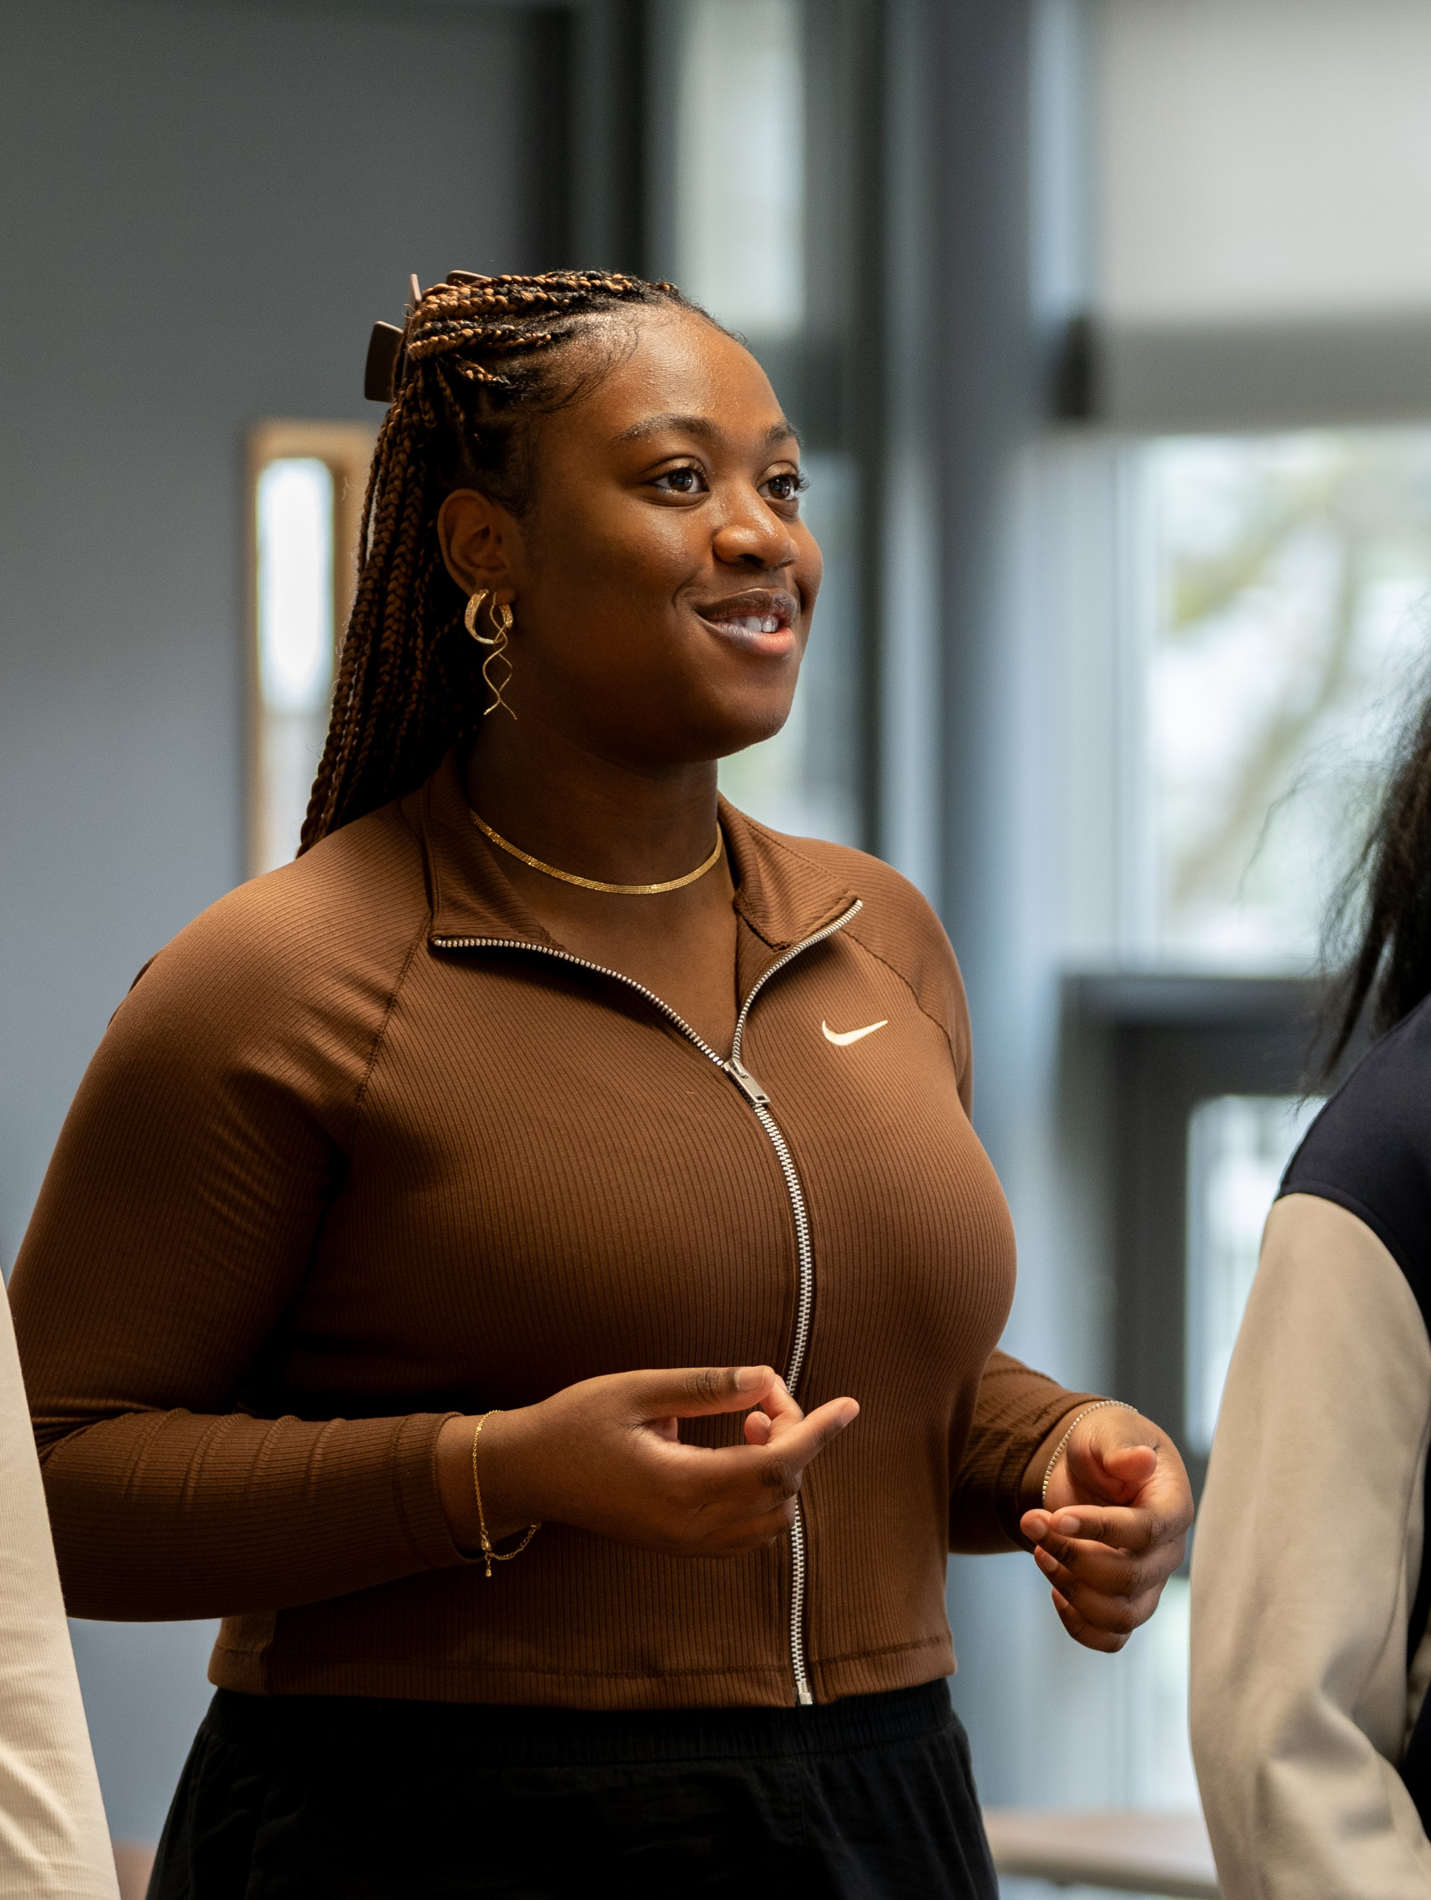
Advocacy Academy
For Year 12/1st Year Students
Event 1
Event 2
Event 3
Defining
Advocacy
Oct/Nov 2024
In sixth form/college session
Explore what advocacy means
Form friendships with others on the programme
Loudspeaker & The Game of Life
Wednesday 20th November 2025
On campus event
Delivered by sector leading partner, Loudspeaker
High energy session to build confidence telling your story
Advocacy
In Practice
Wednesday 11th December 2025
On campus event
Academic session around self-worth, self-awareness and having a strong sense of identity
Experience real life advocacy on a student panel
Advocacy Academy offers priority places for Black, Asian and Minority Ethnic students and those from the Liverpool City region.
All of our access programmes are completely free and include a free lunch on campus visits. We also support travel costs to enable you to attend.
Scan to express your interest

Slide 4
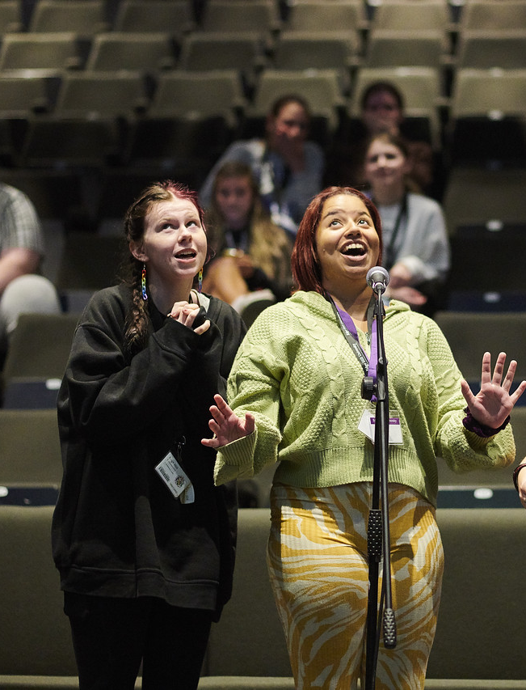
Cutting Edge Creatives Competition
For all school, sixth form and college students in all years of study
Explore this year’s Black History Month theme of Reclaiming Narratives
Submit a…
Short Story
Poem
Music
Song
Dance
Drama
Animation
What are we looking for?
Adherence to and exploration of key theme: Does the submission strongly reflect the theme of reclaiming narratives?
Clarity of presentation and structure: Is it clear what the author is trying to convey, and is it clear why the specific medium has been chosen to reflect the theme?
Originality of thought and expression: Is this something that the panel hasn’t really seen or experienced before?
Use of language or imagery: Is the use of language or images precise, sophisticated and imaginatively rich?
The Wow Factor: Something that makes the judging panel feel excited or full of admiration.
A celebration and prizegiving event for shortlisted entrants and supporters will take place on the Edge Hill University Ormskirk campus on Saturday 5th April 2025.
All of our access programmes are completely free and include a free lunch on campus visits. We also support travel costs to enable you to attend.
Scan to express your interest

Slide 5

Access Programmes and Activities
Diversity Access Programme
For Black, Asian & Minority Ethnic Year 12/1st year students, this programme aims to demystify university life and empower you to see higher education as place where you can belong.
Ignite Access Programme
For Year 12/1st year students who have received free school meals, this programme allows you to explore an unfiltered version of university life.
Advocacy Academy
Primarily for Black, Asian & Minority Ethnic and Liverpool City Region students, Advocacy Academy focuses on personal growth and develops your ability to advocate for yourself and others
Cutting Edge Creatives Competition
For all school, sixth form and college students, the Cutting Edge Creatives Competition allows you to express yourself creatively around this year’s theme Reclaiming Narratives
All of our access programmes are completely free and include a free lunch on campus visits. We also support travel costs to enable you to attend. Some programmes carry a reduced offer on completion of all events.
Scan to express your interest

