Slide 1
Join us at a Subject taster day
Biology Olympiad
Business
Computing
Dance, Drama & Musical Theatre
Earth Games Olympiad
Education & Teaching
Engineering
English & Creative Writing
History, Geosciences & Social Sciences
Law, Criminology & Policing
Media & Film
Medicine
Psychology
Sport & Physical Activity

Slide 2
Join us at an
Open Day
Join us at an
Open day
2024﻿
FRIDAY 5 JULY
SATURDAY 6 JULY
SATURDAY 17 AUGUST
SATURDAY 12 OCTOBER
SATURDAY 2ND NOVEMBER
SATURDAY 23RD NOVEMBER

Slide 3
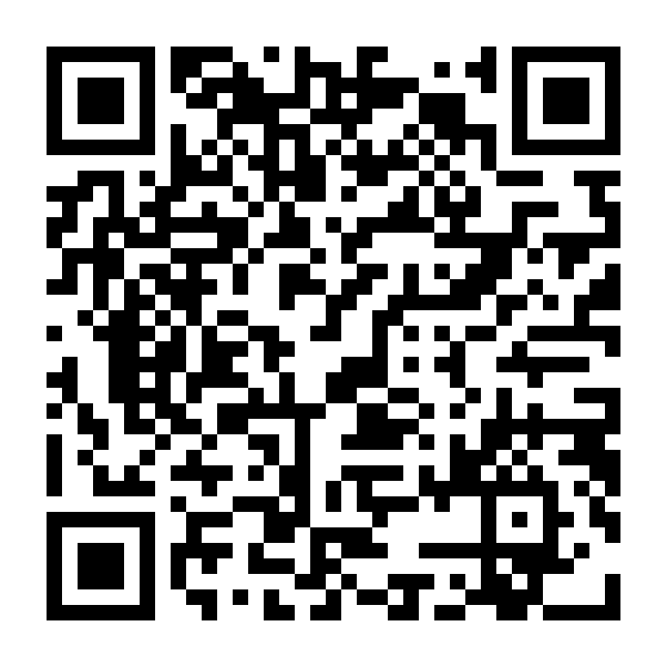
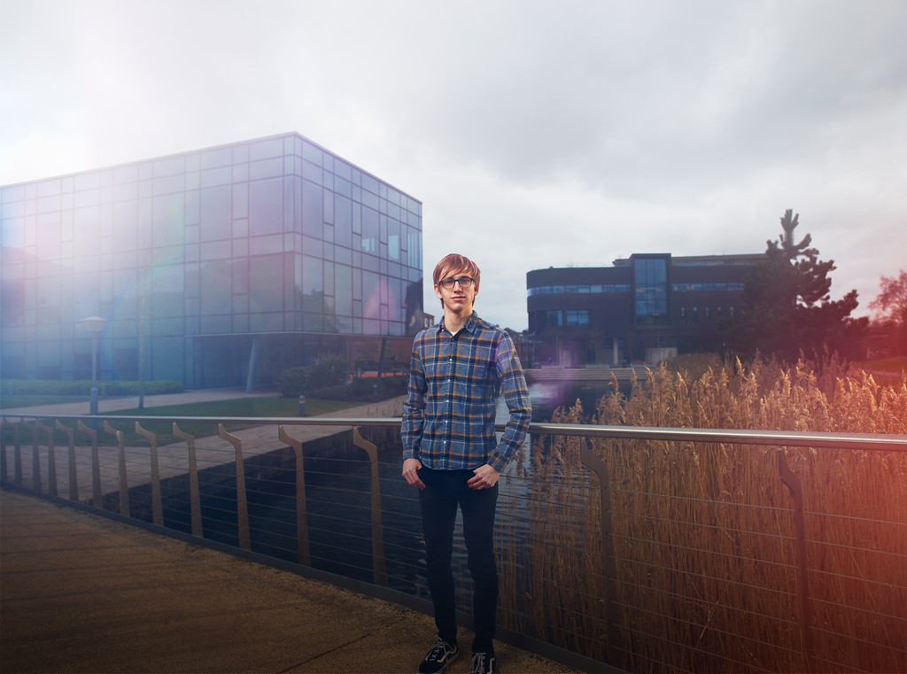
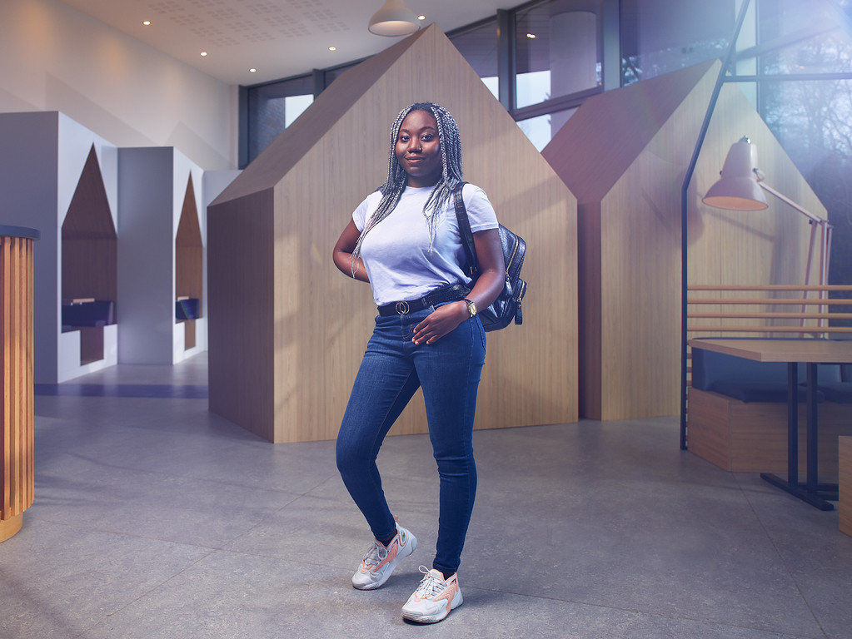
TAP platform
Scan the QR code and chat to current students about:
Student life/experience
Their course and department
Accommodation/commuting
Expand your Opportunities with Edge Hill

Slide 4
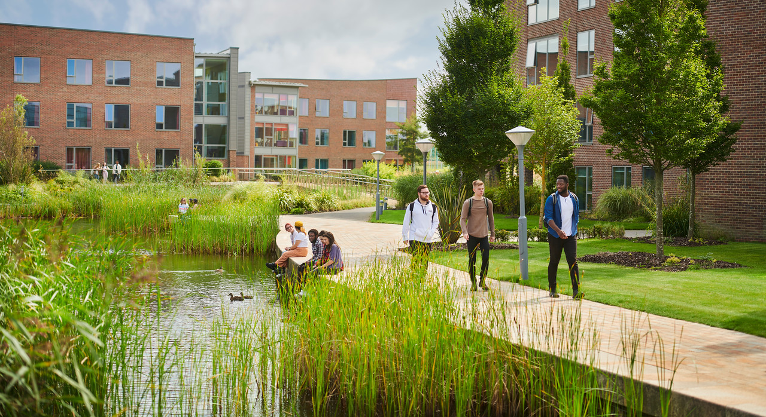
Diversity Access Programme
A free, one-year programme for Year 12 or Year One Black, Asian and Minority Ethnic Students which supports you on your journey to Higher Education.
What does it include?
Subject taster sessions from across our faculties
Experience student life activities with our current students and alumni
Support with the HE application process and personal statements
Completion of the programme will qualify you for a reduced offer to study at Edge Hill* (*excluding Medicine courses)
Interested? Contact us via wideningaccessandparticipation@edgehill.ac.uk

