Slide 1
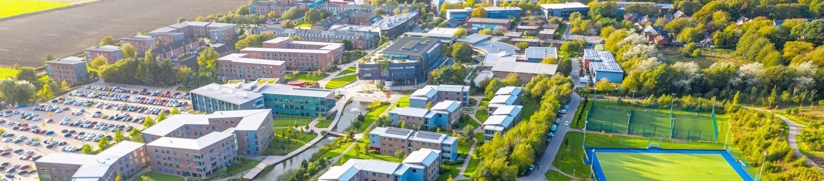
A home from home
Top 4 in the North West (Complete University Guide 2025)
5th in the UK (Uni Compare, 2026)
1st in the UK for accommodation (Uni Compare 2024, 2025 and 2026)
5th in the UK for student voice (National Student Survey 2025)
The highest graduate outcomes in the North West (96.2% are in work or further study 15 months after graduation (Graduate Outcomes data released 2025 from 2022/23 graduates))
One of the UK’s best green spaces for 15 years running (Green Flag Award 2025)

Slide 2
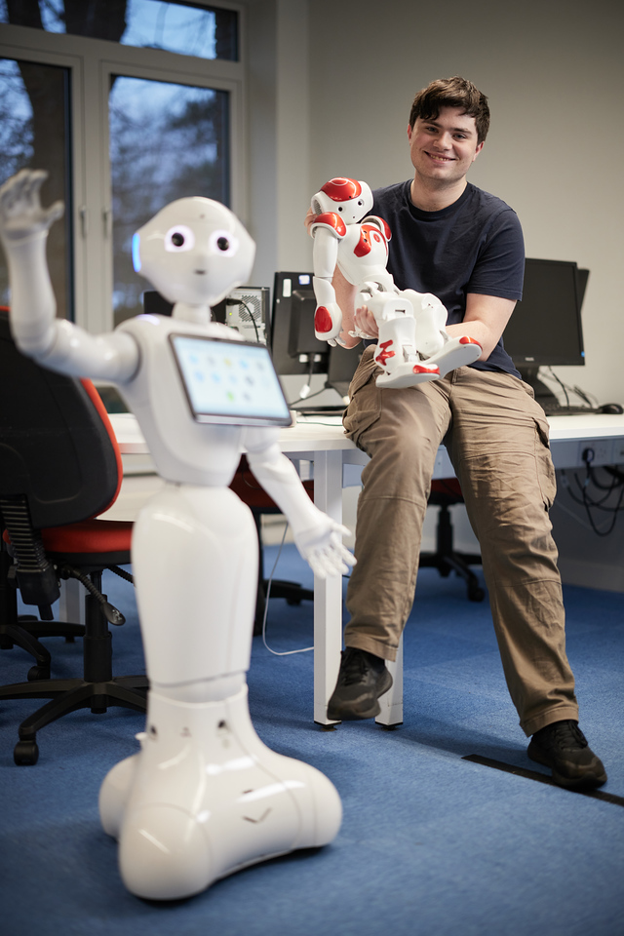
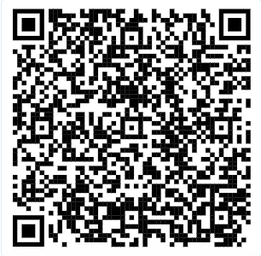
Subject taster days
Throughout Autumn and Spring/Summer terms
attend introduction and taster sessions in their chosen subject
explore how school and university subjects relate to different career paths
find out about Edge Hill University’s facilities, accommodation and campus
find out more about Higher Education (HE)
speak to current students and staff
ask any questions you may have.

Slide 3
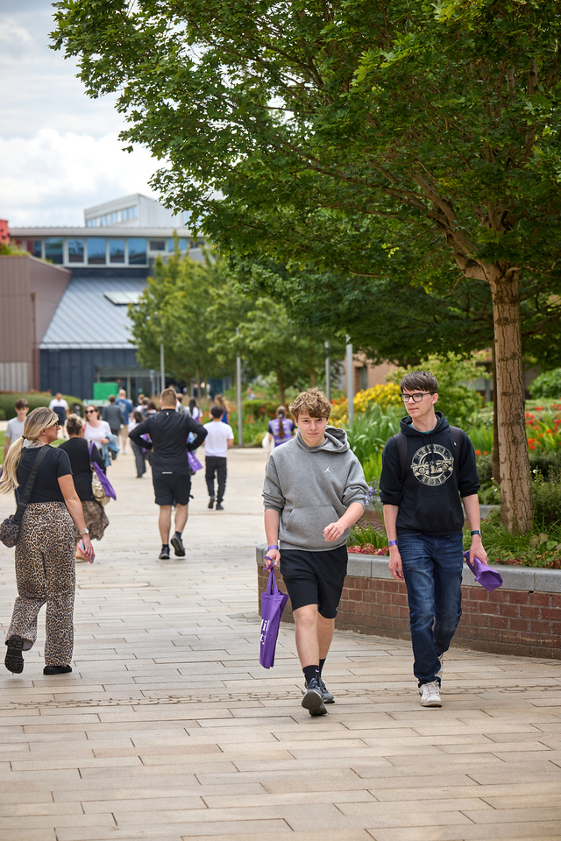
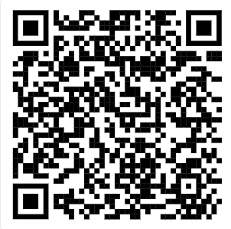
Open days
Join us at an upcoming open day
Saturday 16th October 2025
Saturday 18th November 2025
Monthly campus tours

